Slide 1
DevOps Lab

Slide 2
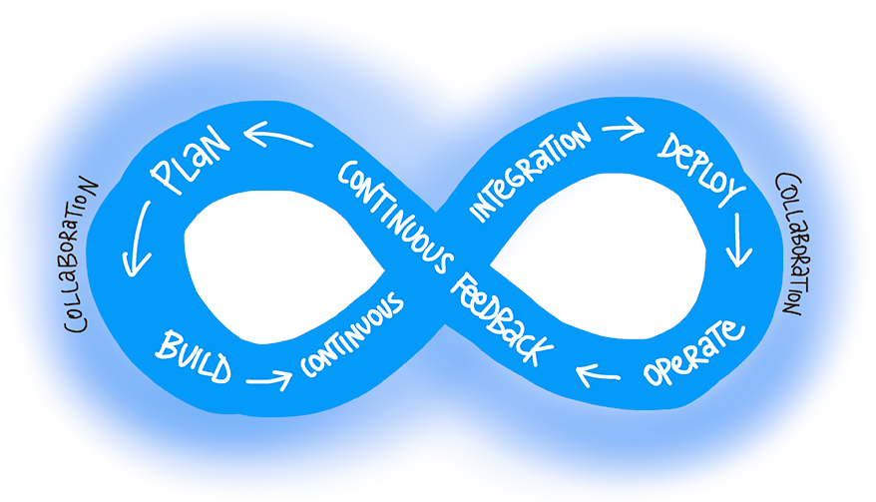
Lab 1: Azure DevOps
Concepts

Slide 3
Lab 1: Azure DevOps
DevOps is the union of people, process, and products to enable continuous delivery of value to our end users. The contraction of “Dev” and “Ops” refers to replacing siloed Development and Operations to create multidisciplinary teams that now work together with shared and efficient practices and tools. Essential DevOps practices include agile planning, continuous integration, continuous delivery, and monitoring of applications.

Slide 4
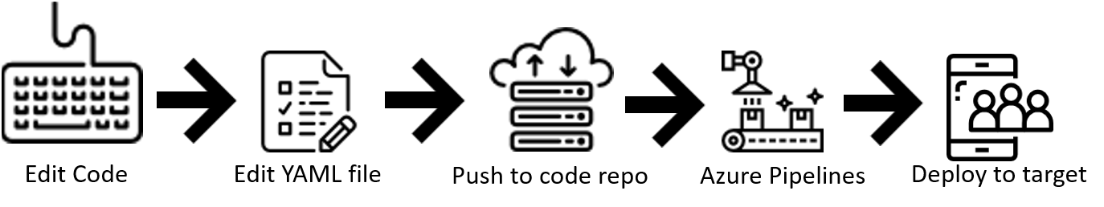
Lab 1: Azure DevOps
Use Azure Pipelines with YAML
Benefits of using YAML
The pipeline is versioned with your code and follows the same branching structure. You get validation of your changes through code reviews in pull requests and branch build policies.
Every branch you use can modify the build policy by modifying the azure-pipelines.yml file.
A change to the build process might cause a break or result in an unexpected outcome. Because the change is in version control with the rest of your codebase, you can more easily identify the issue.

Slide 5
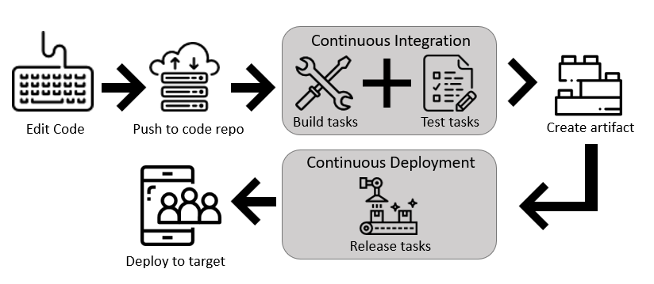
Lab 1: Azure DevOps
Use Azure Pipelines in the visual designer
Benefits of using the visual designer The visual designer is great for users who are new to the world of continuous integration (CI) and continuous delivery (CD).
The visual representation of the pipelines makes it easier to get started.
The visual designer is located in the same hub as the build results. This location makes it easier to switch back and forth and make changes.

Slide 6
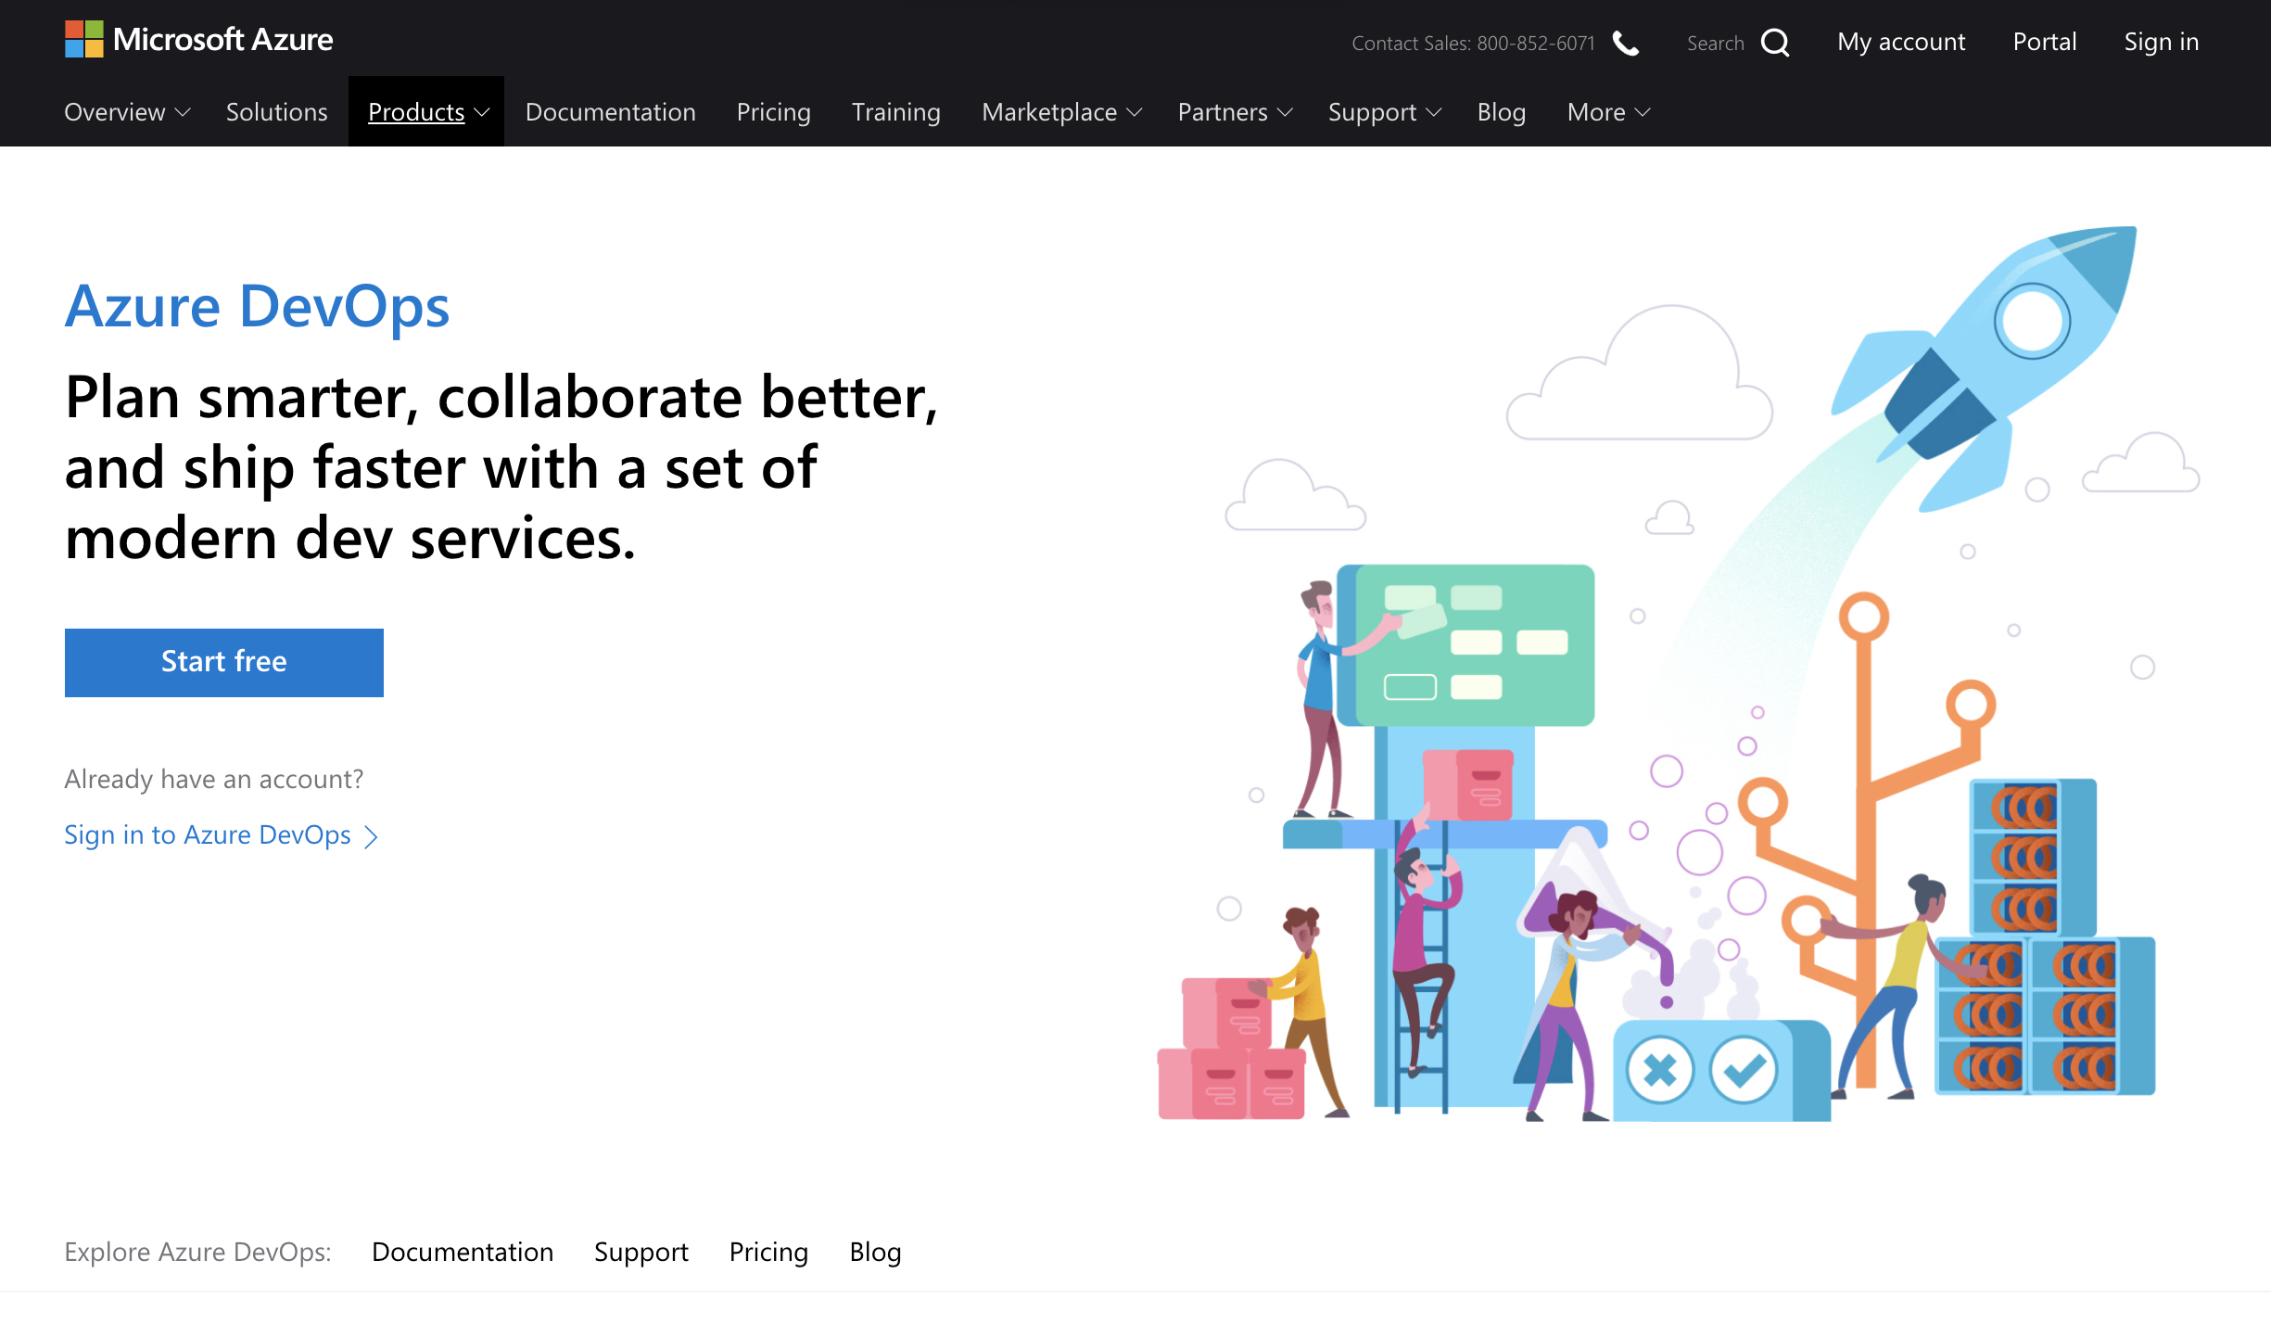
Lab 1: Azure DevOps

Slide 7
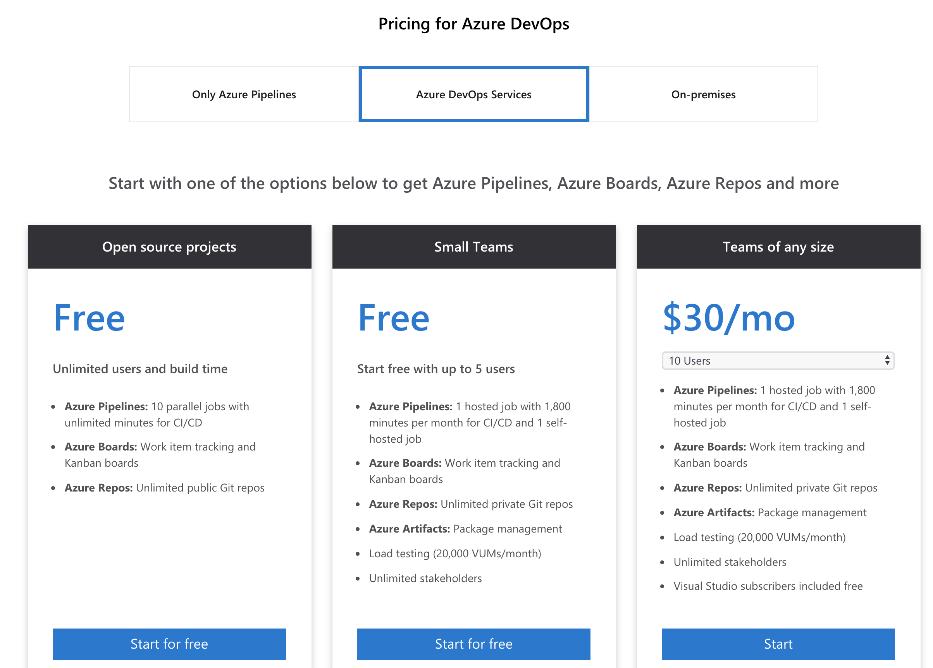
Lab 1: Azure DevOps

Slide 8
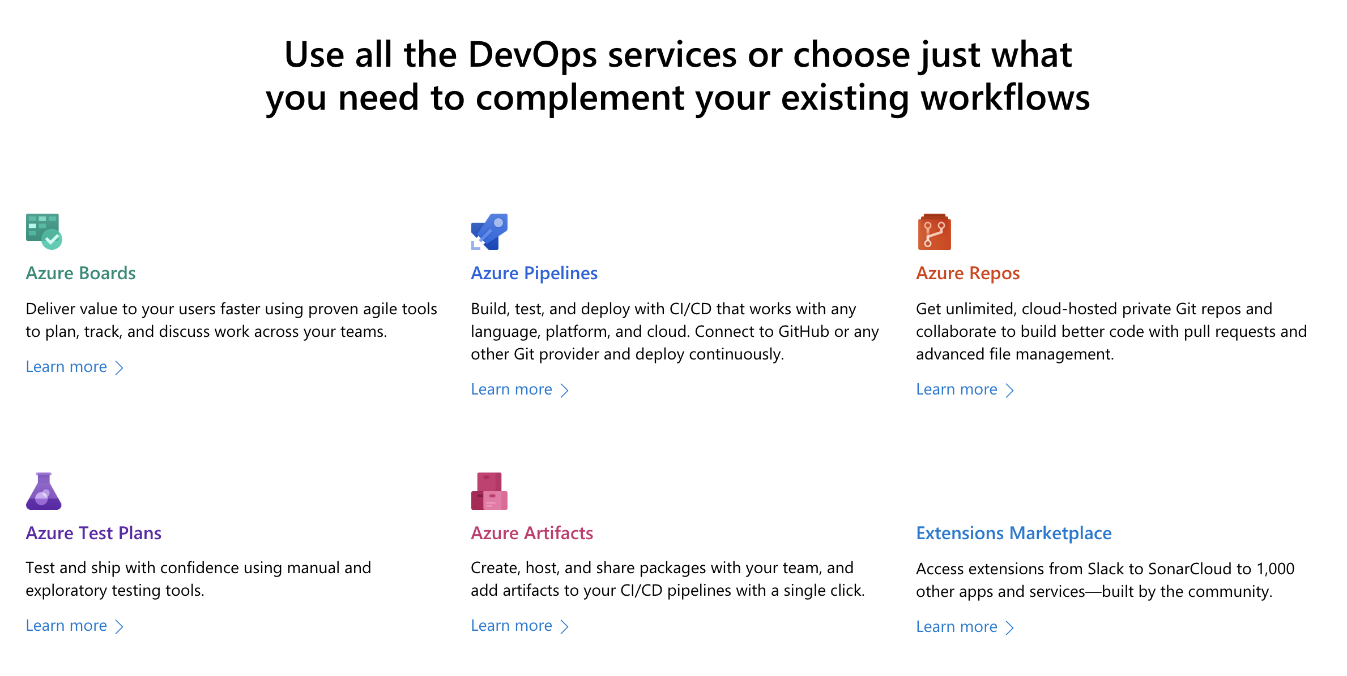
Lab 1: Azure DevOps

Slide 9
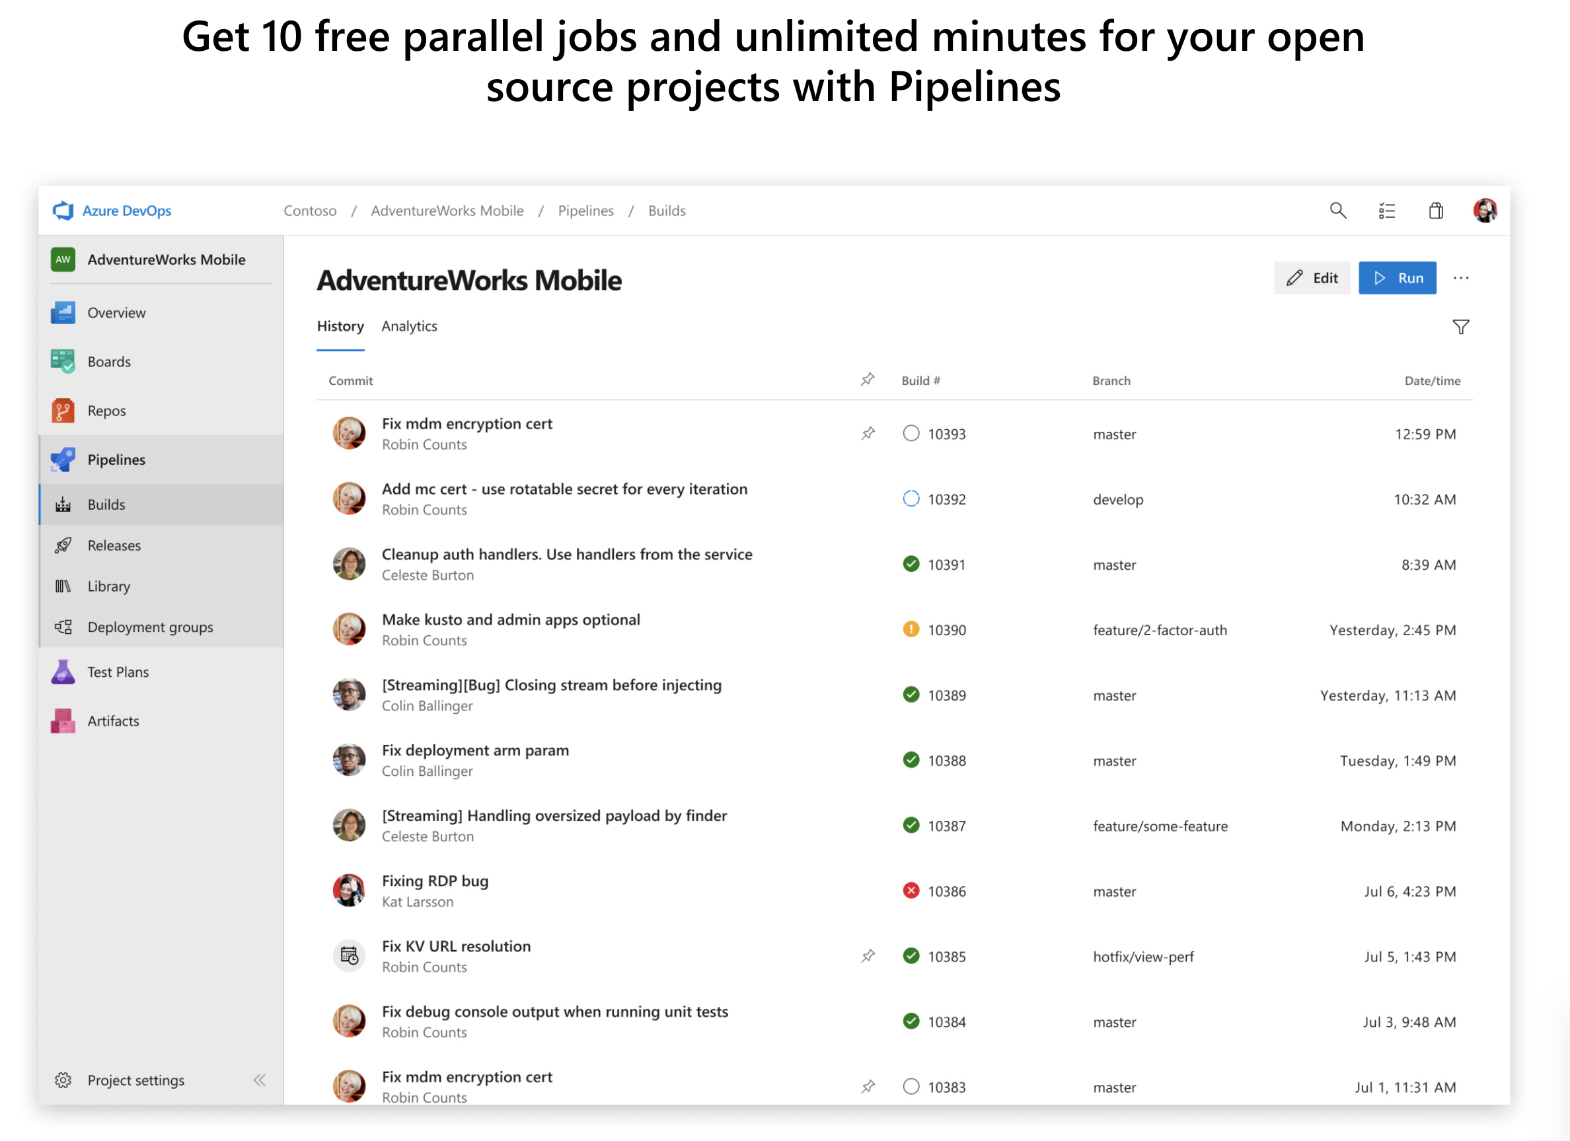
Lab 1: Azure DevOps

Slide 10
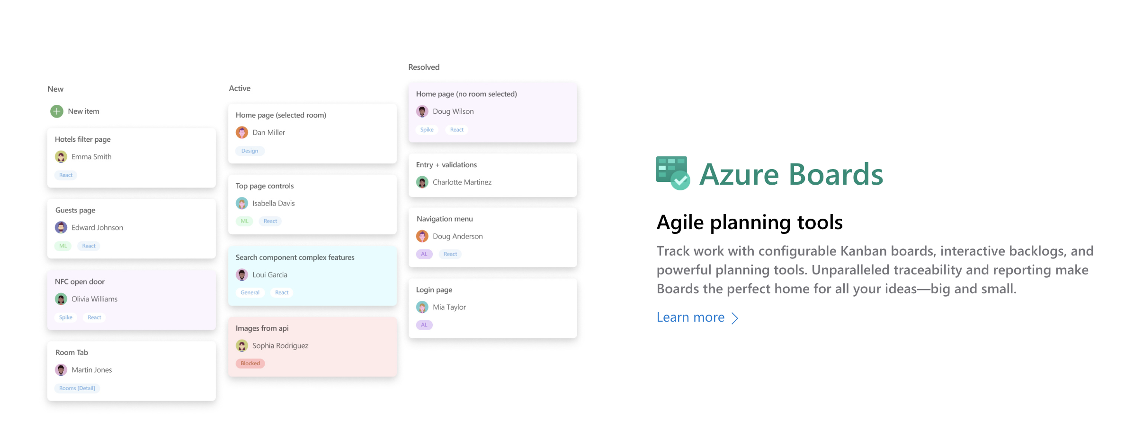
Lab 1: Azure DevOps

Slide 11
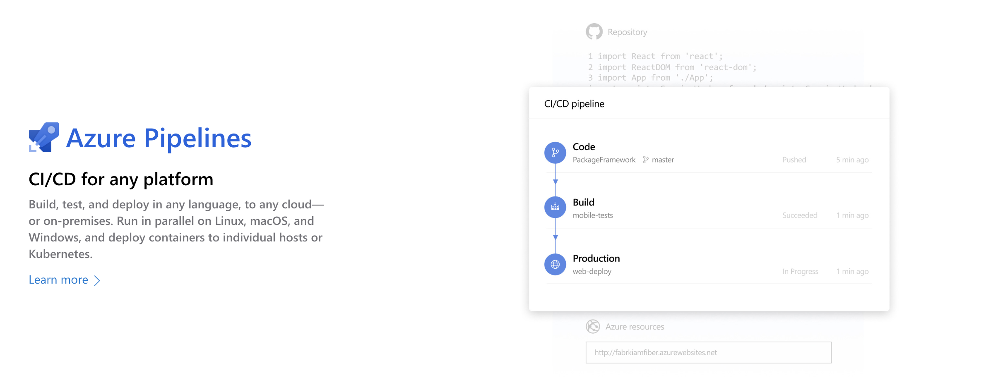
Lab 1: Azure DevOps

Slide 12
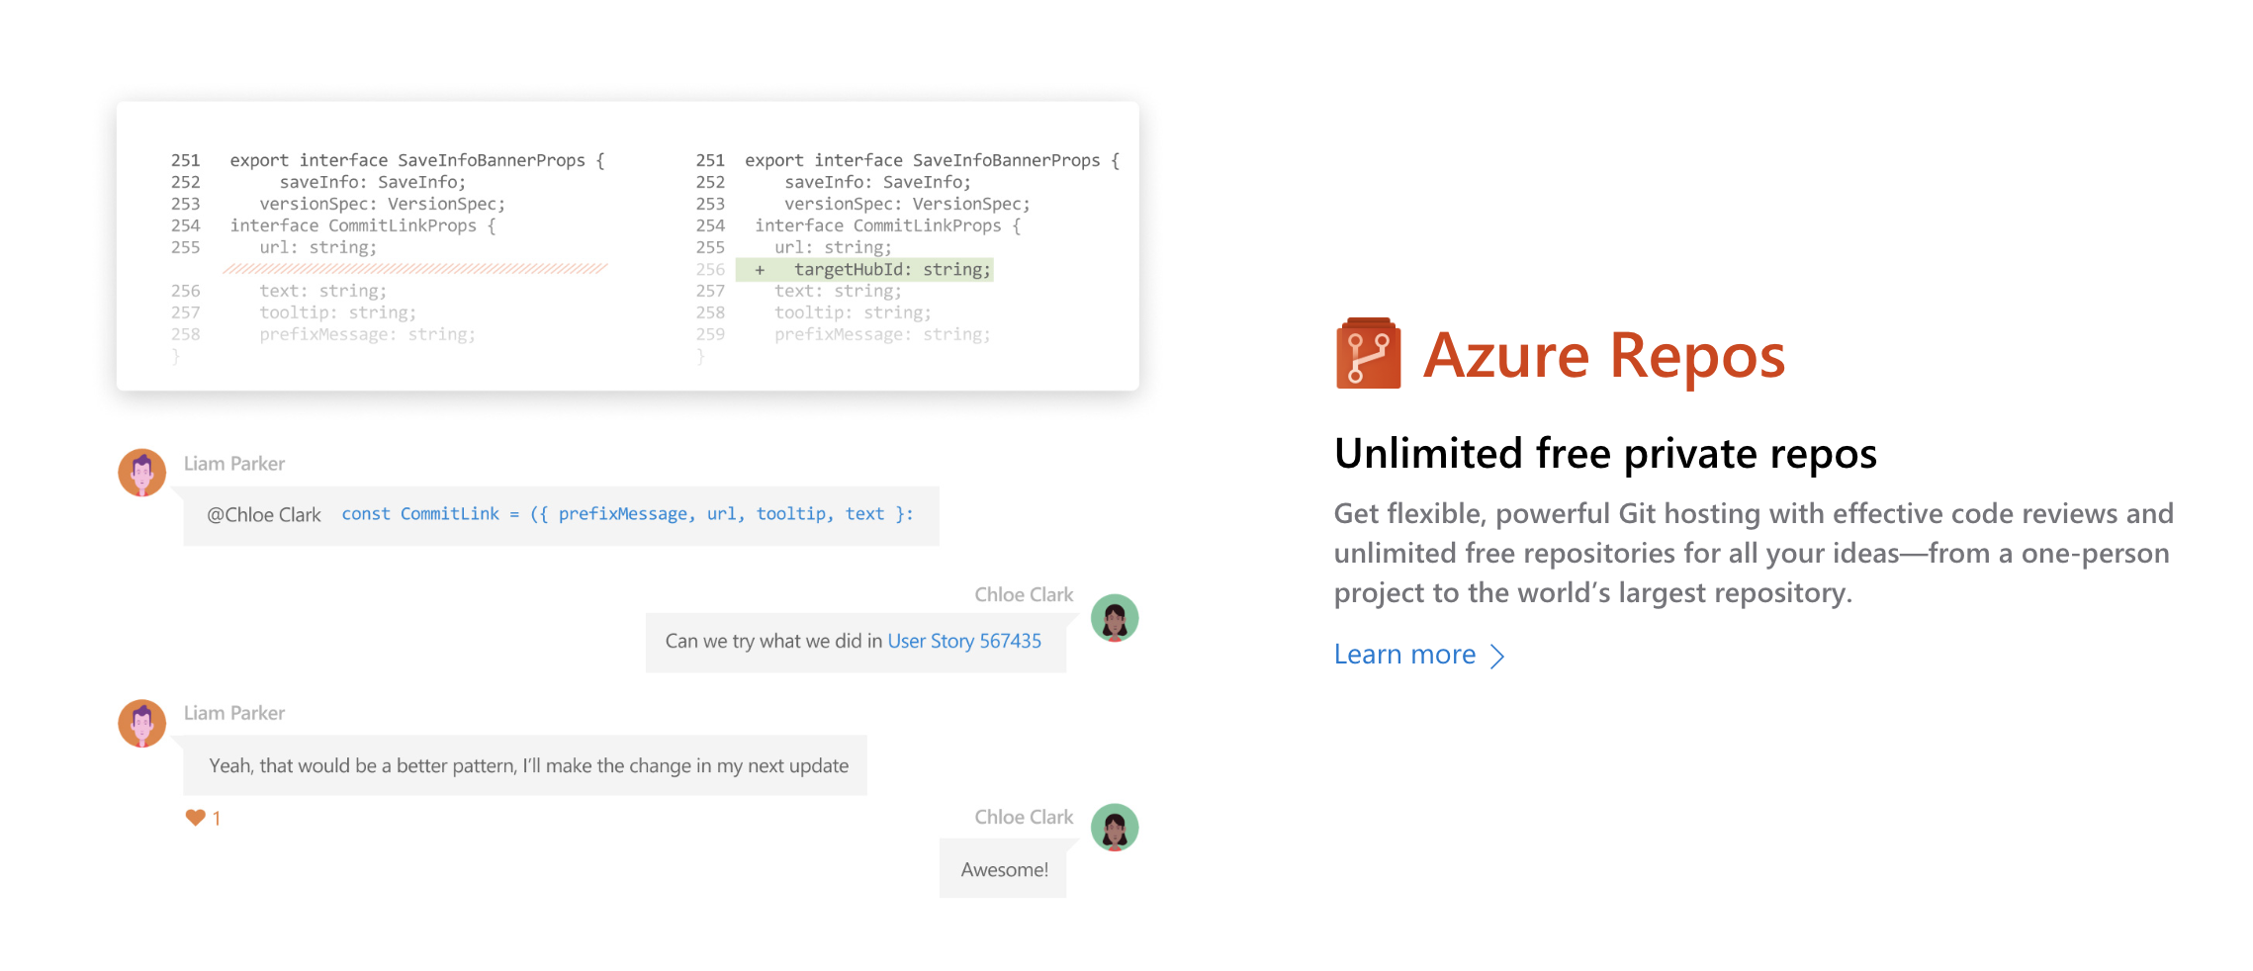
Lab 1: Azure DevOps

Slide 13
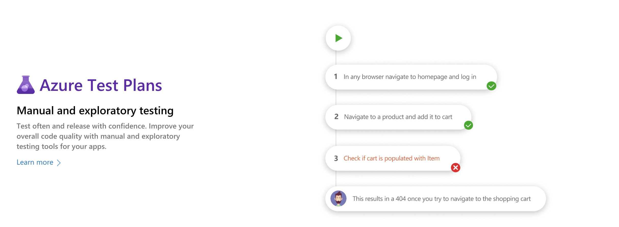
Lab 1: Azure DevOps

Slide 14
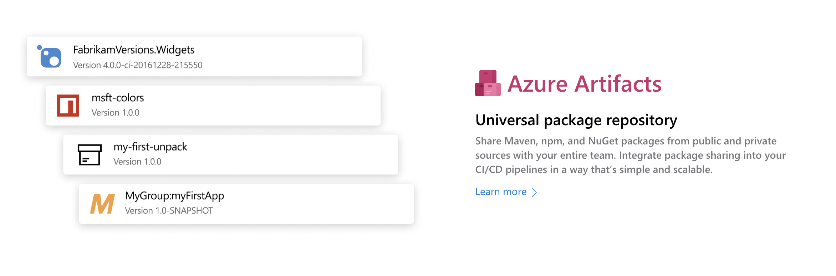
Lab 1: Azure DevOps

Slide 15
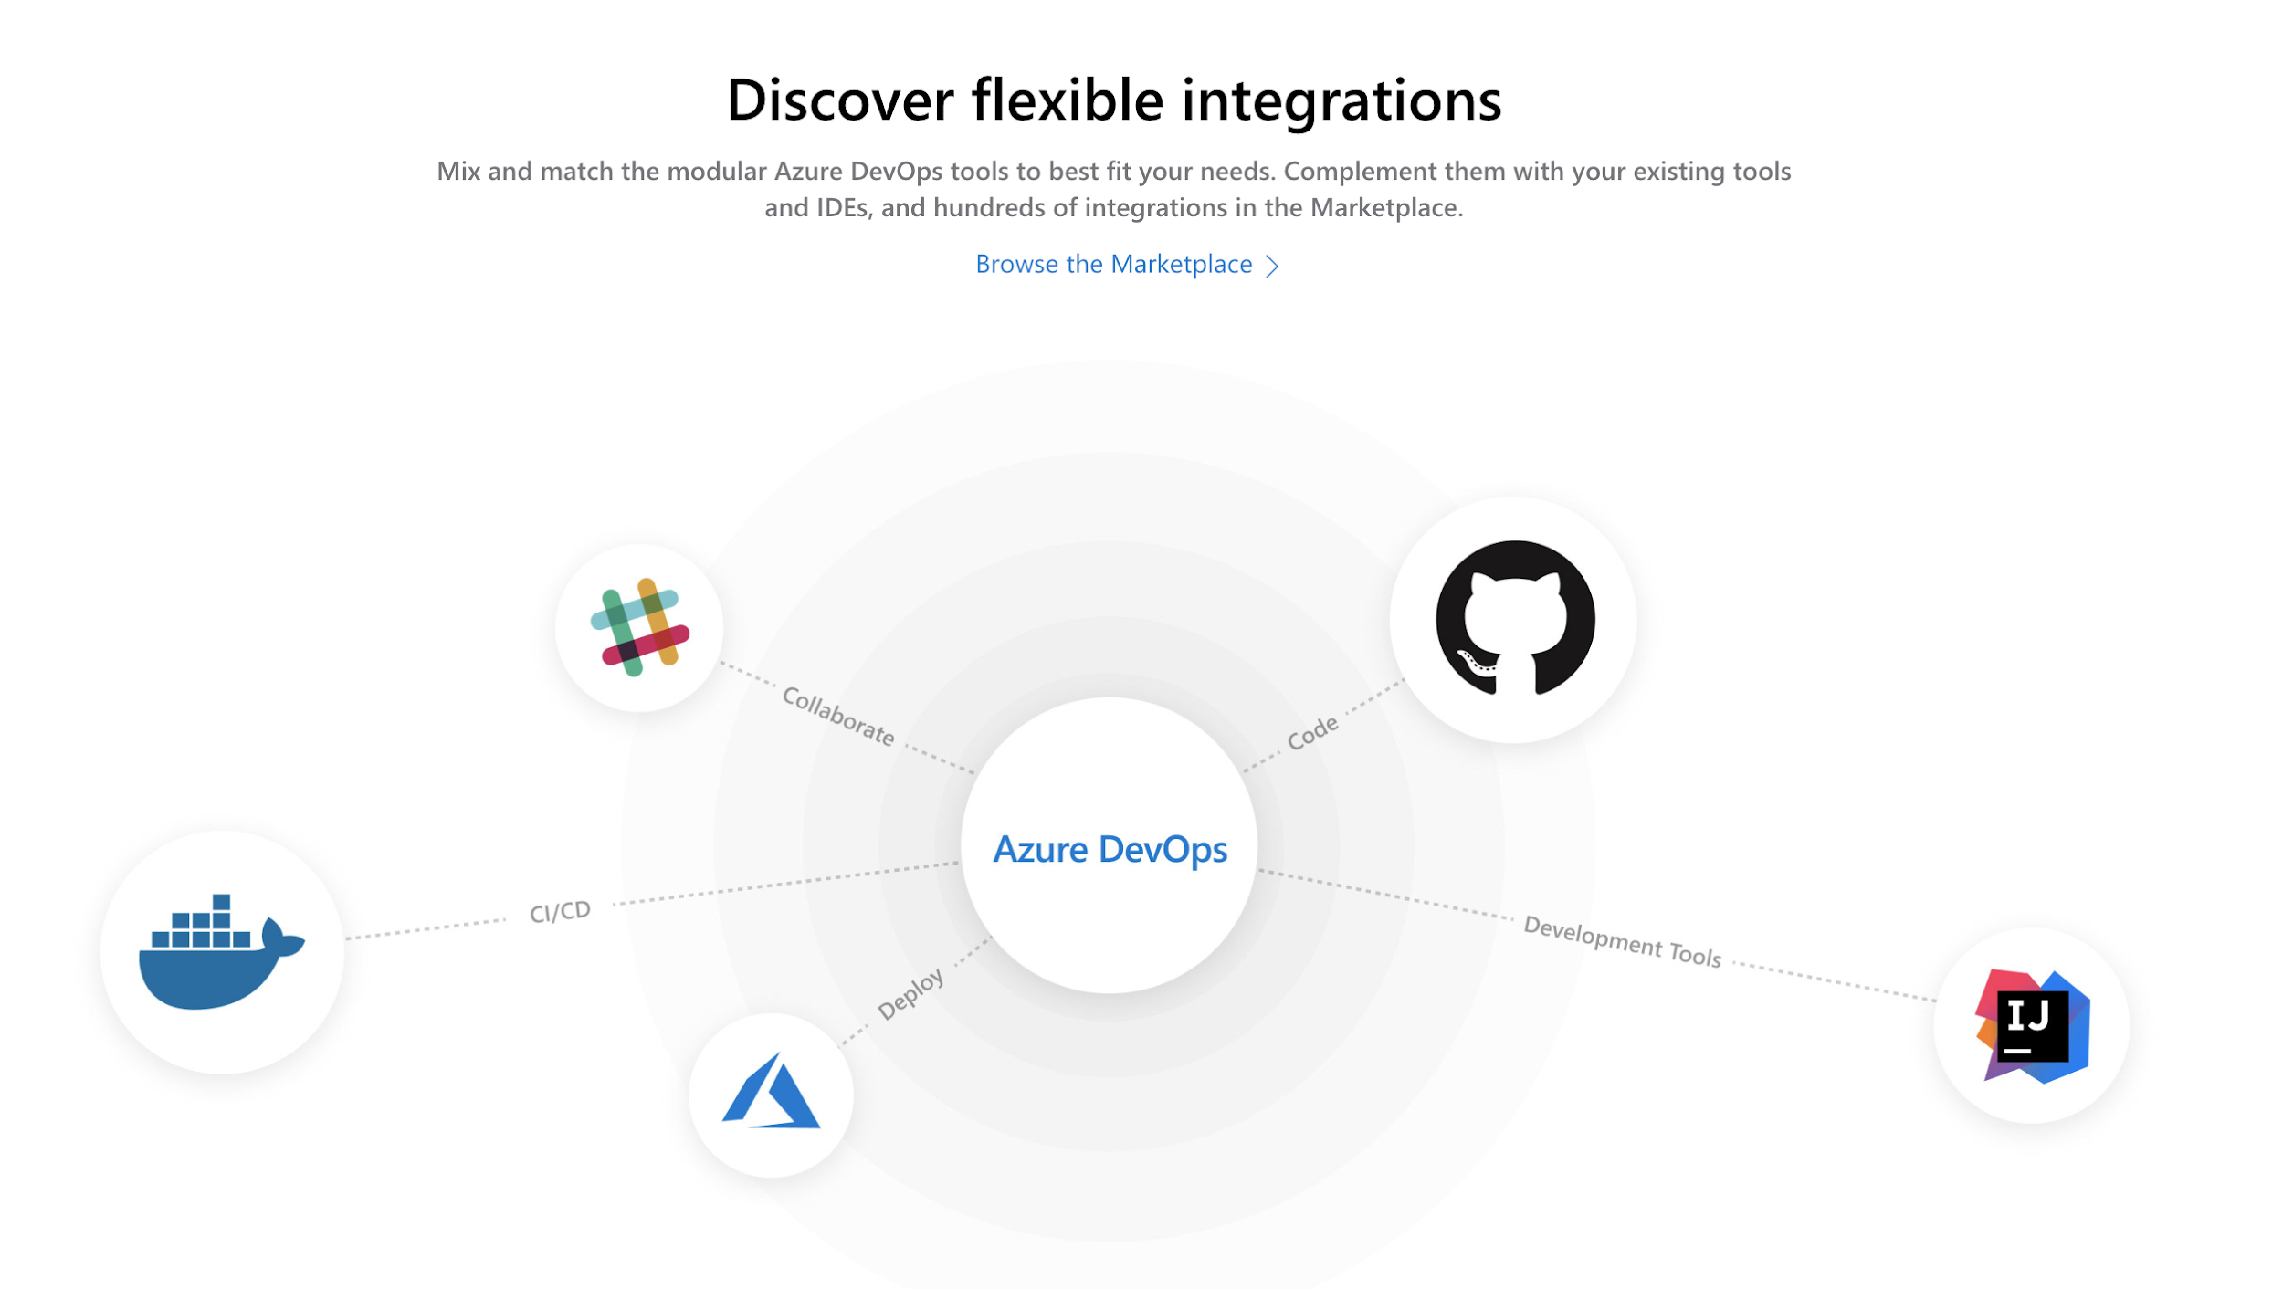
Lab 1: Azure DevOps

Slide 16
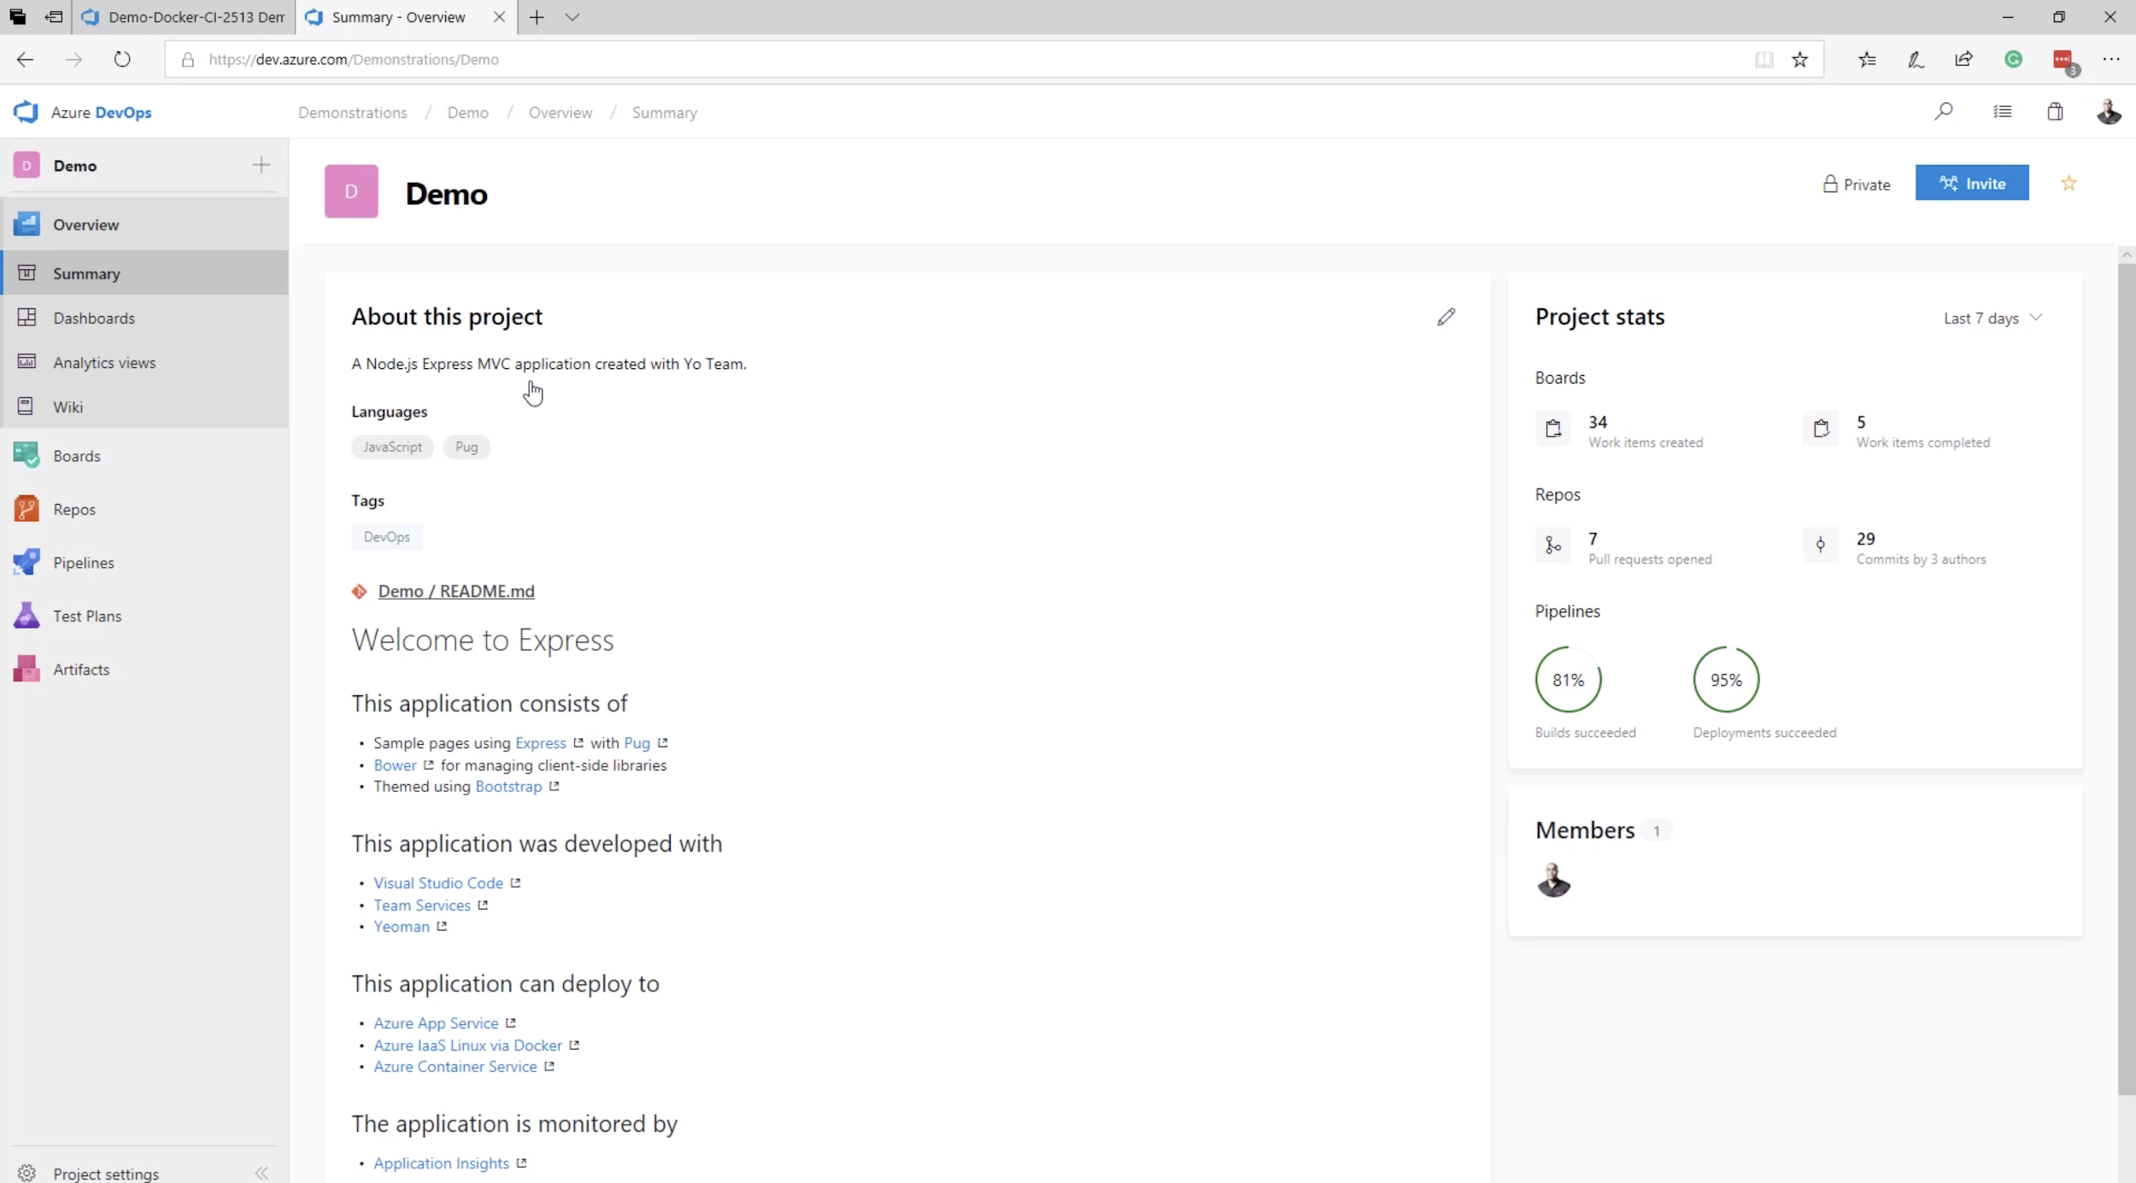
Lab 1: Azure DevOps
What can we do with Azure DevOps

Slide 17
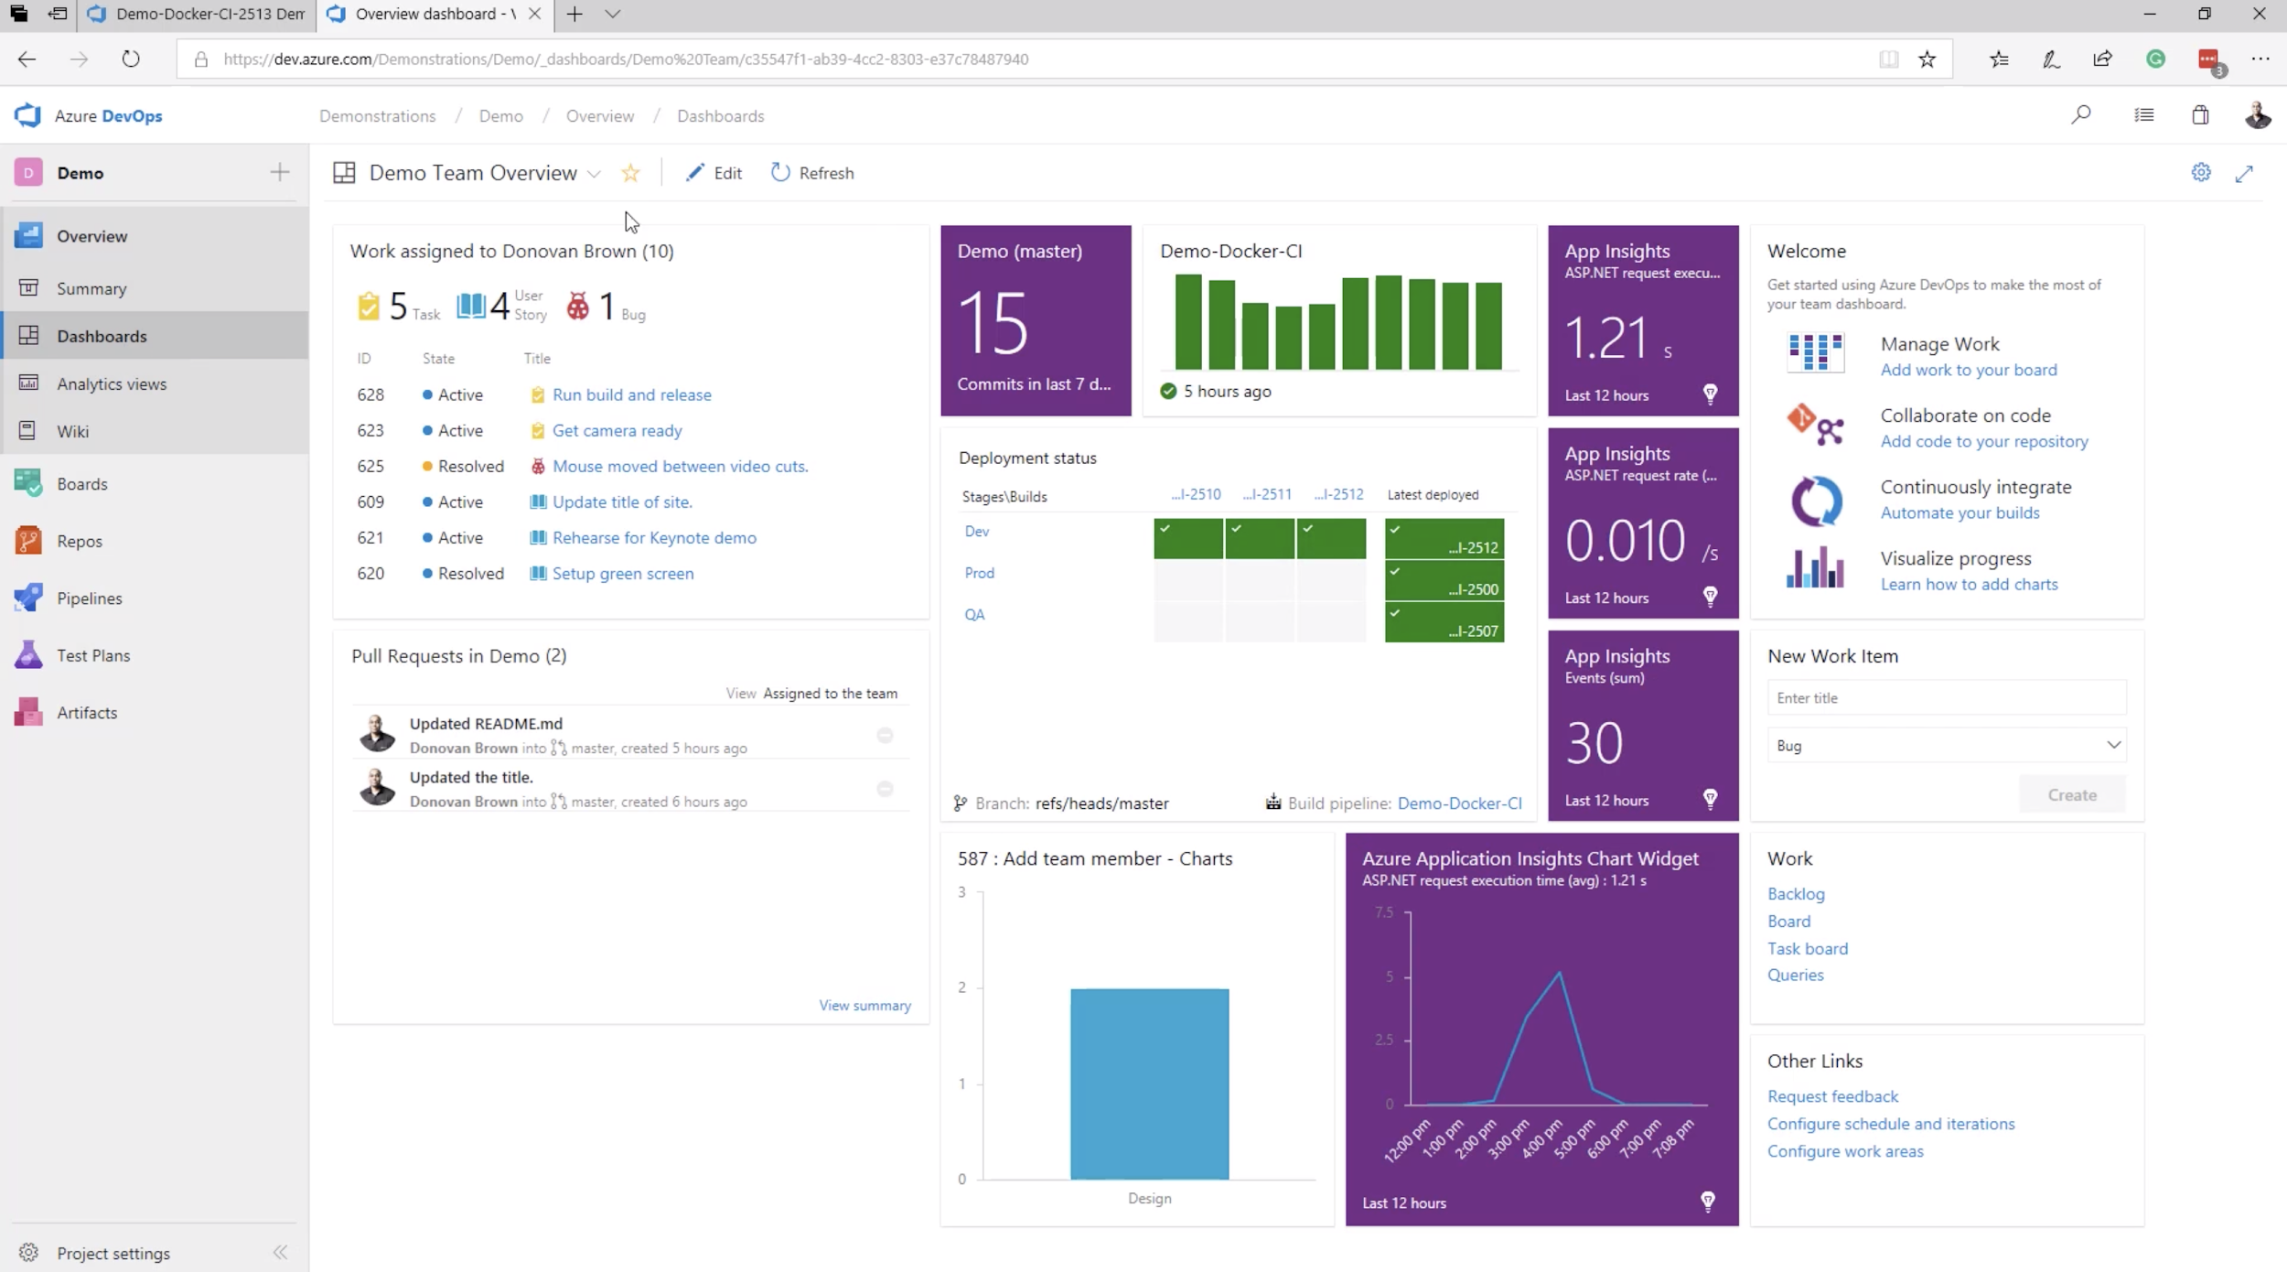
Lab 1: Azure DevOps

Slide 18
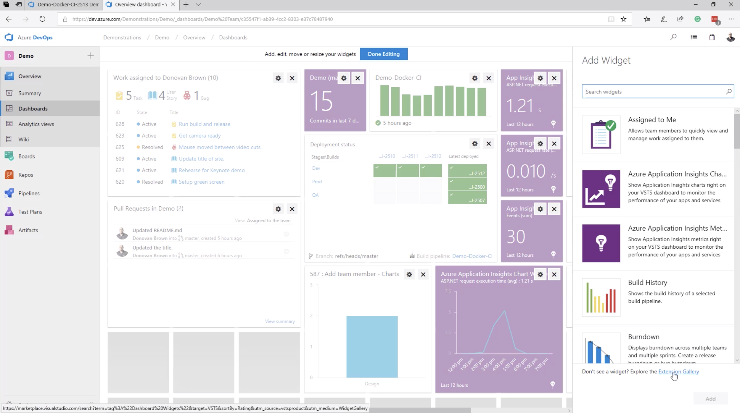
Lab 1: Azure DevOps

Slide 19
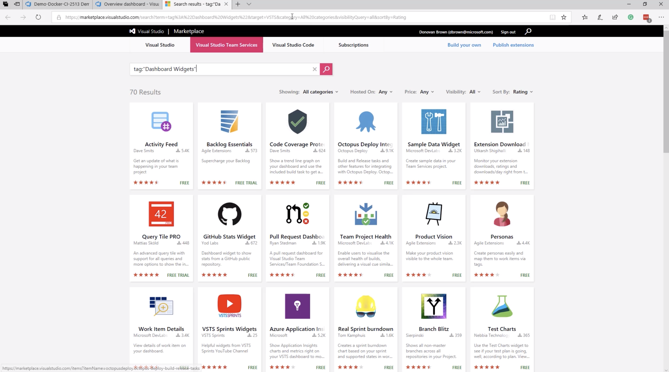
Lab 1: Azure DevOps

Slide 20
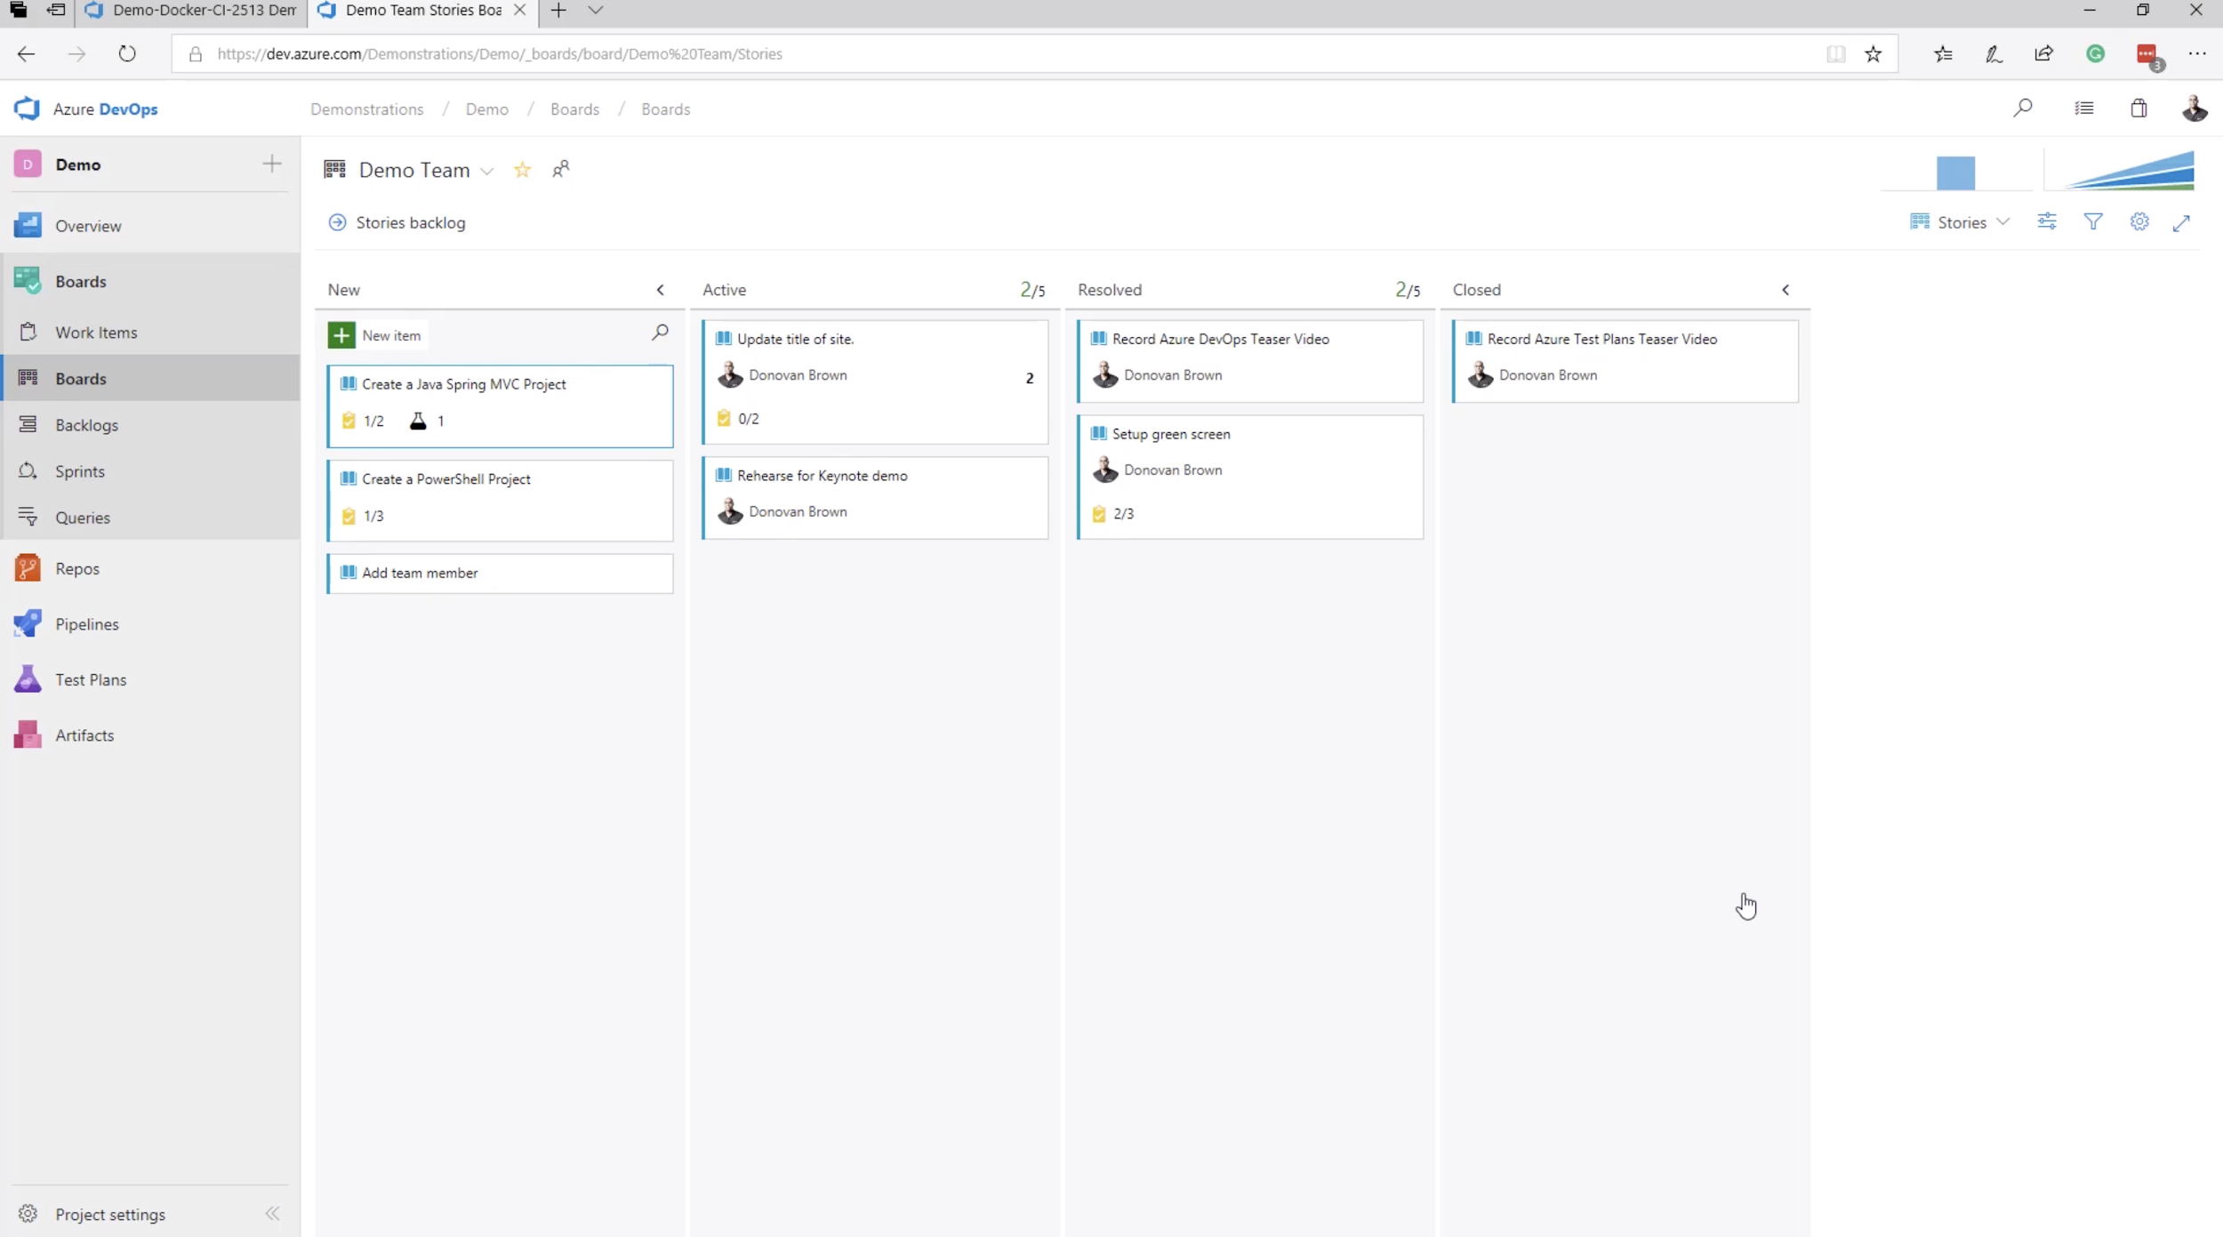
Lab 1: Azure DevOps

Slide 21
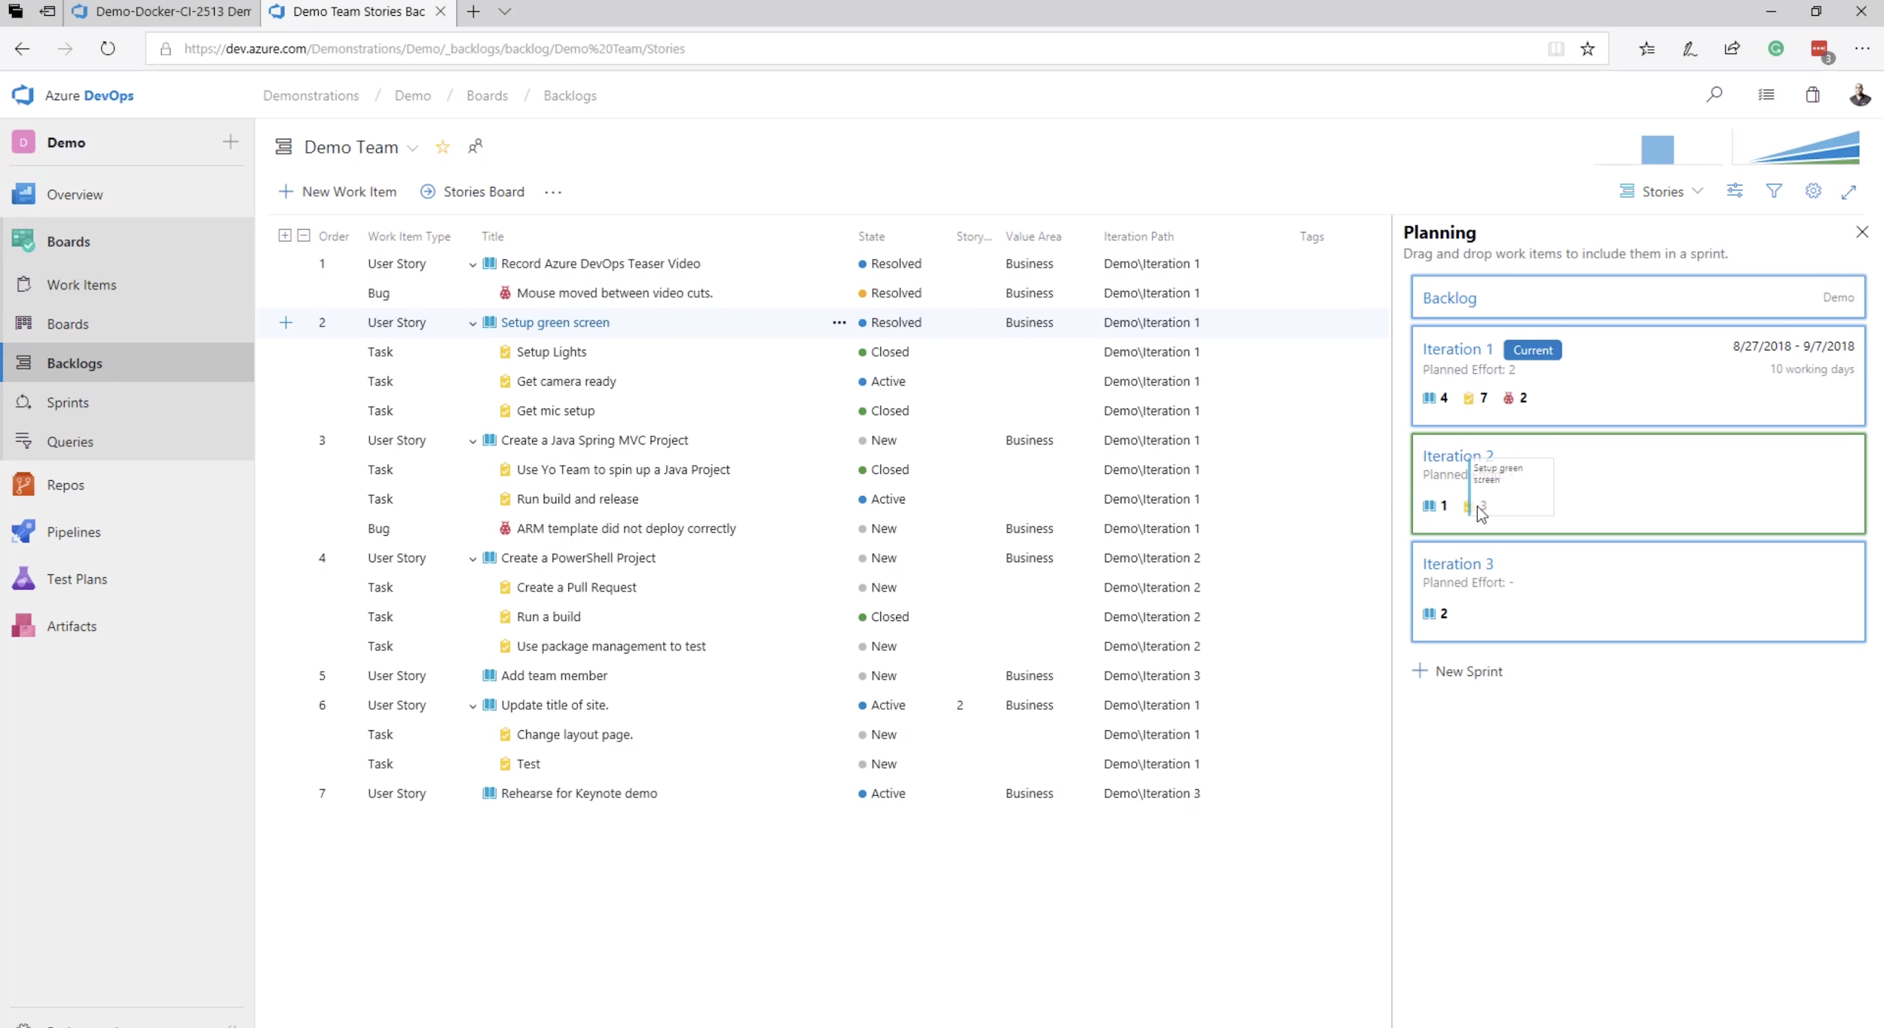
Lab 1: Azure DevOps

Slide 22
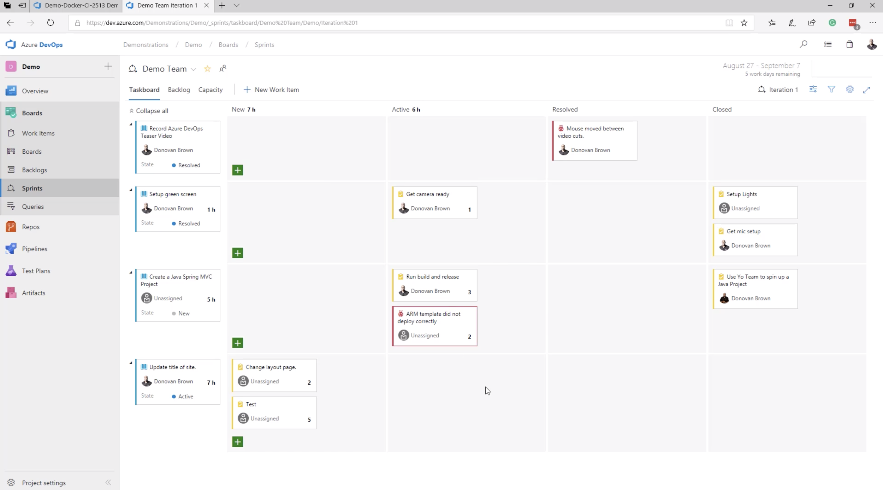
Lab 1: Azure DevOps

Slide 23
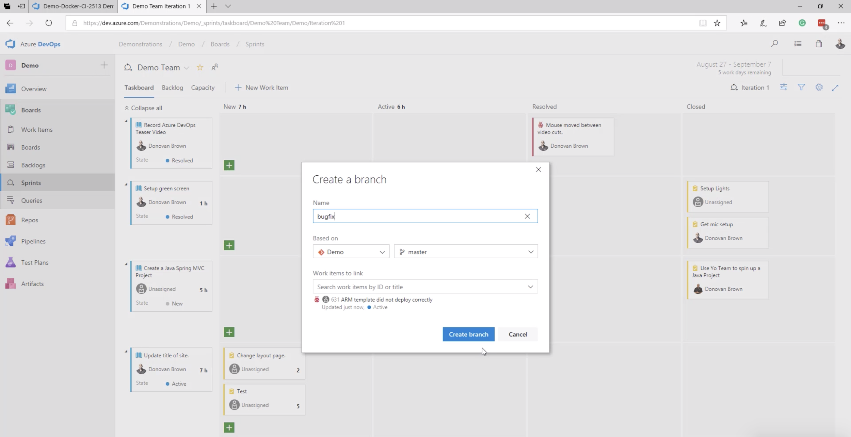
Lab 1: Azure DevOps

Slide 24
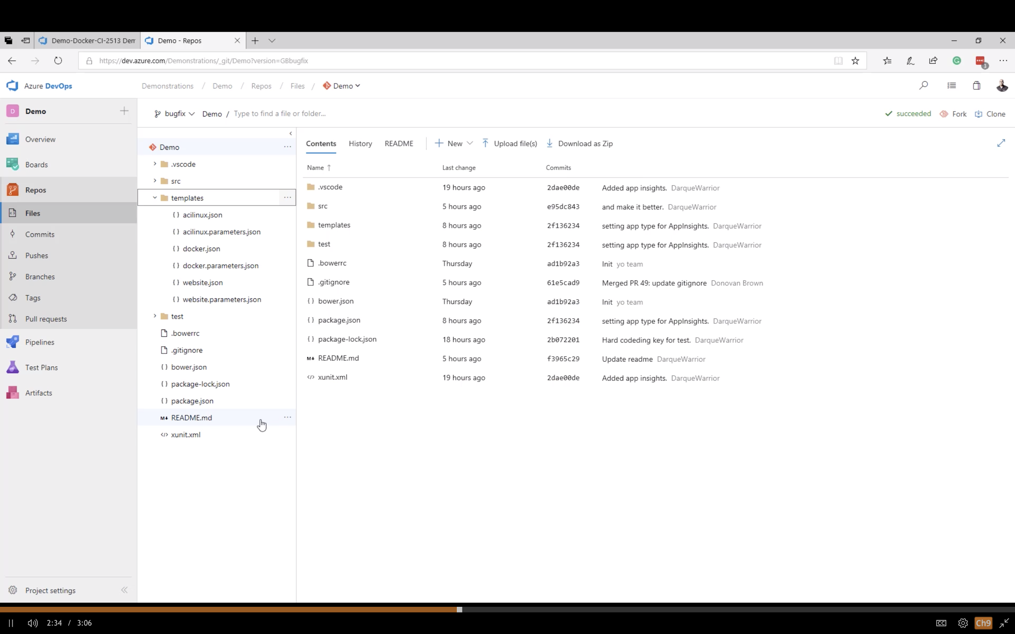
Lab 1: Azure DevOps

Slide 25
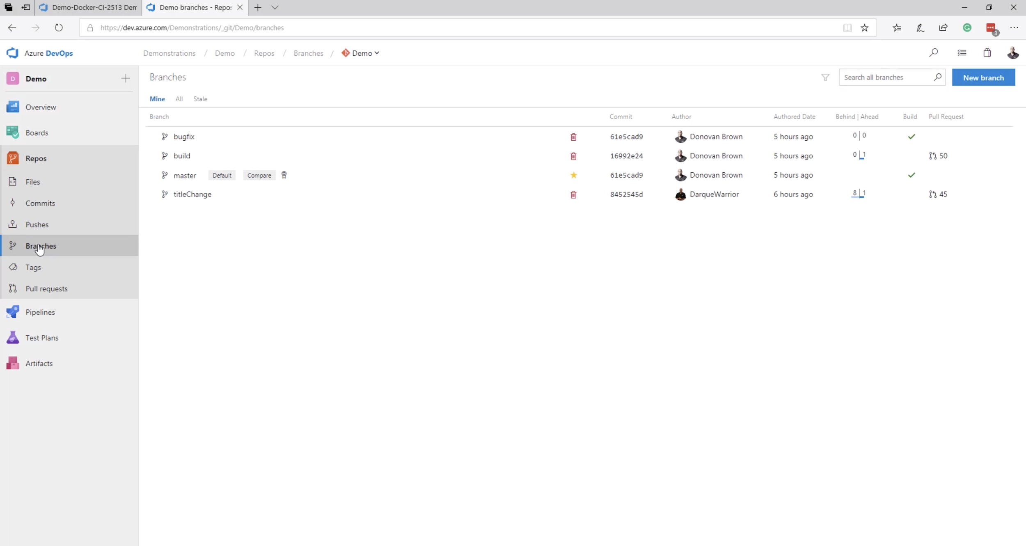
Lab 1: Azure DevOps

Slide 26
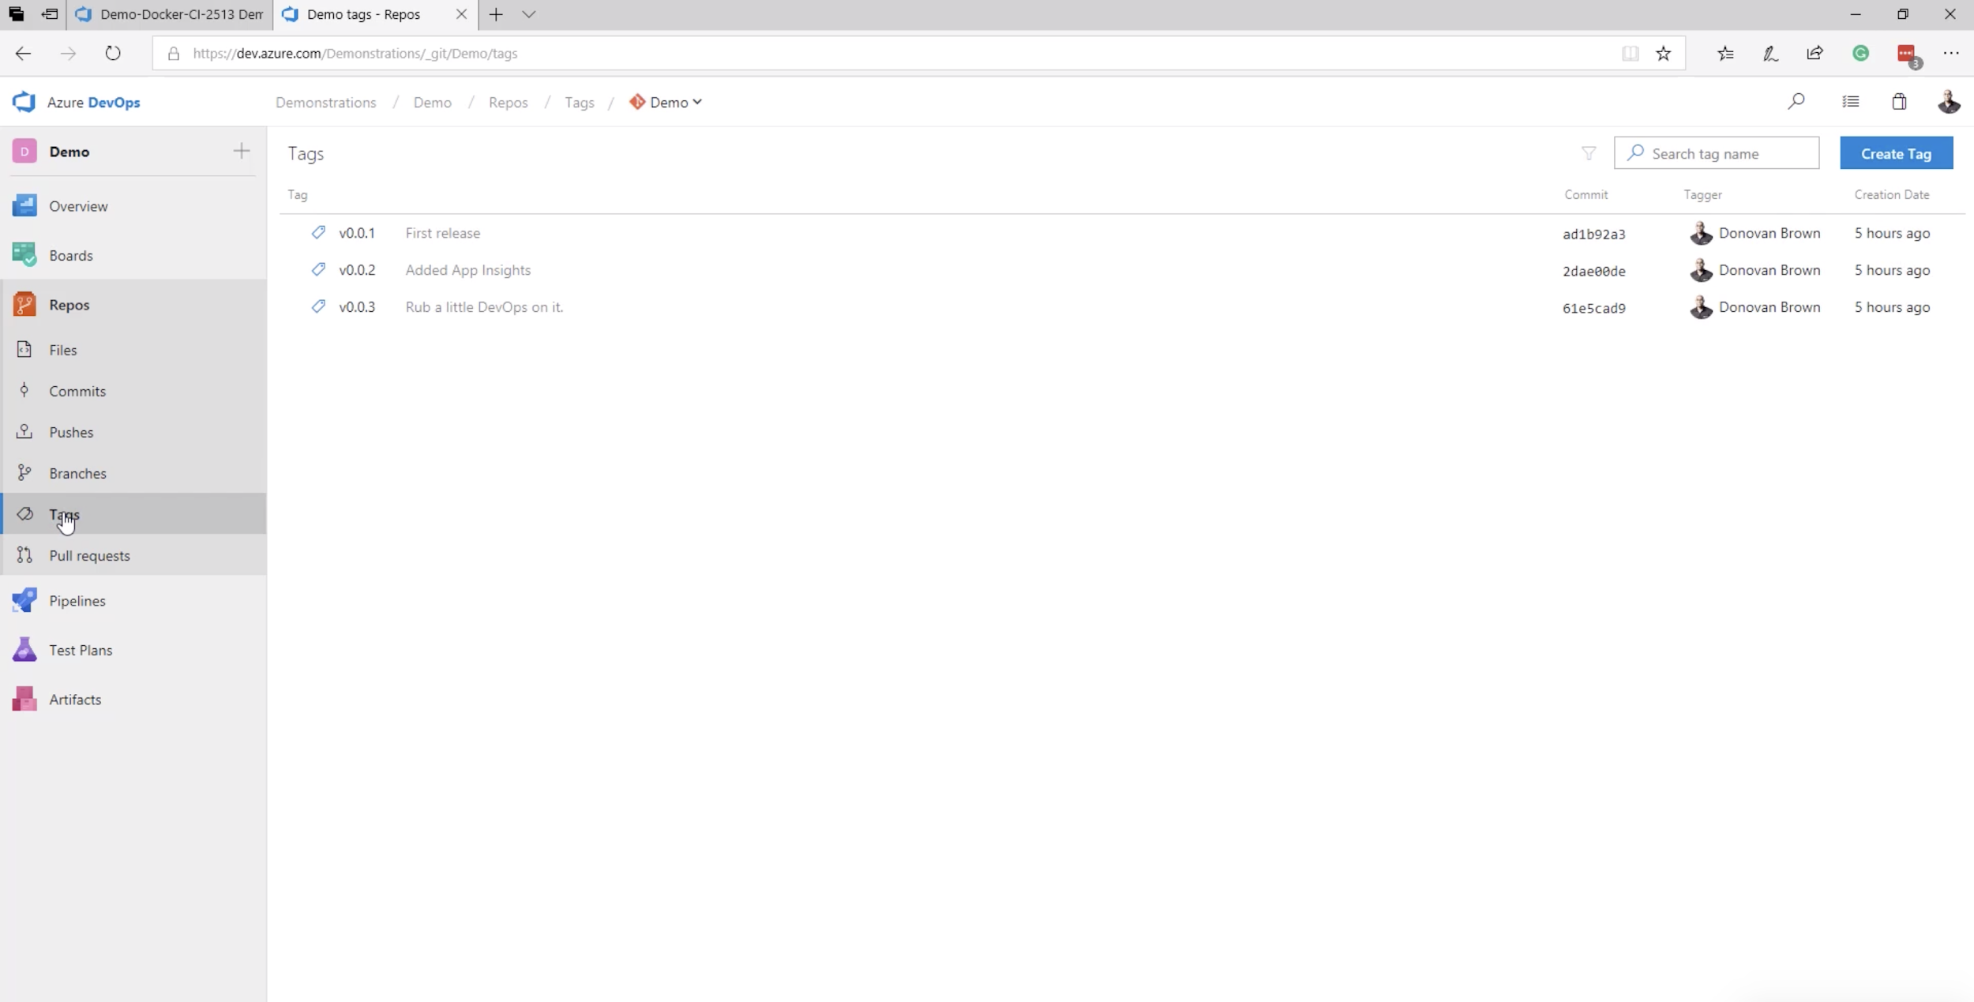
Lab 1: Azure DevOps

Slide 27
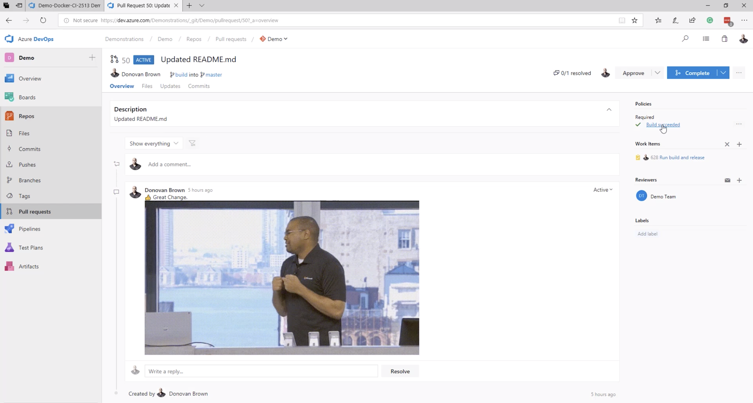
Lab 1: Azure DevOps

Slide 28
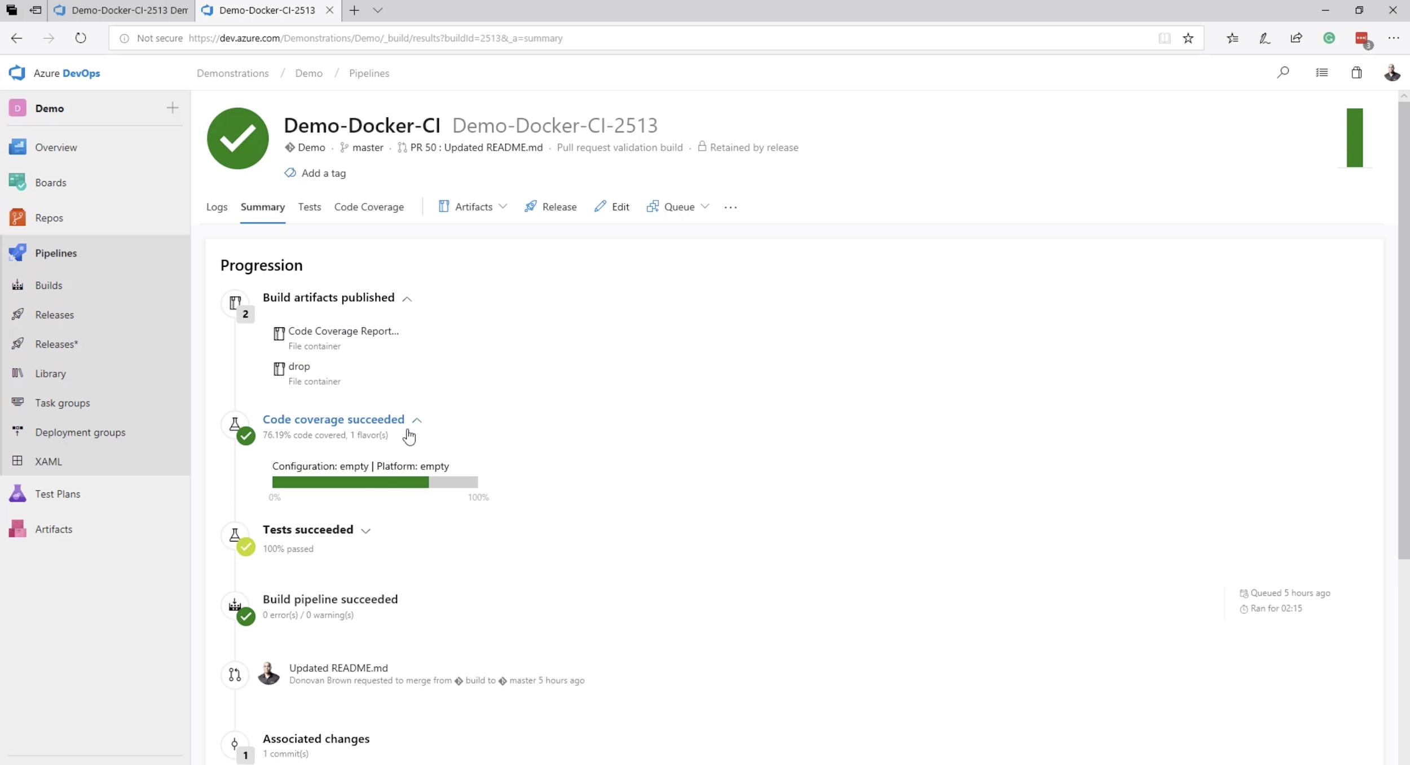
Lab 1: Azure DevOps

Slide 29
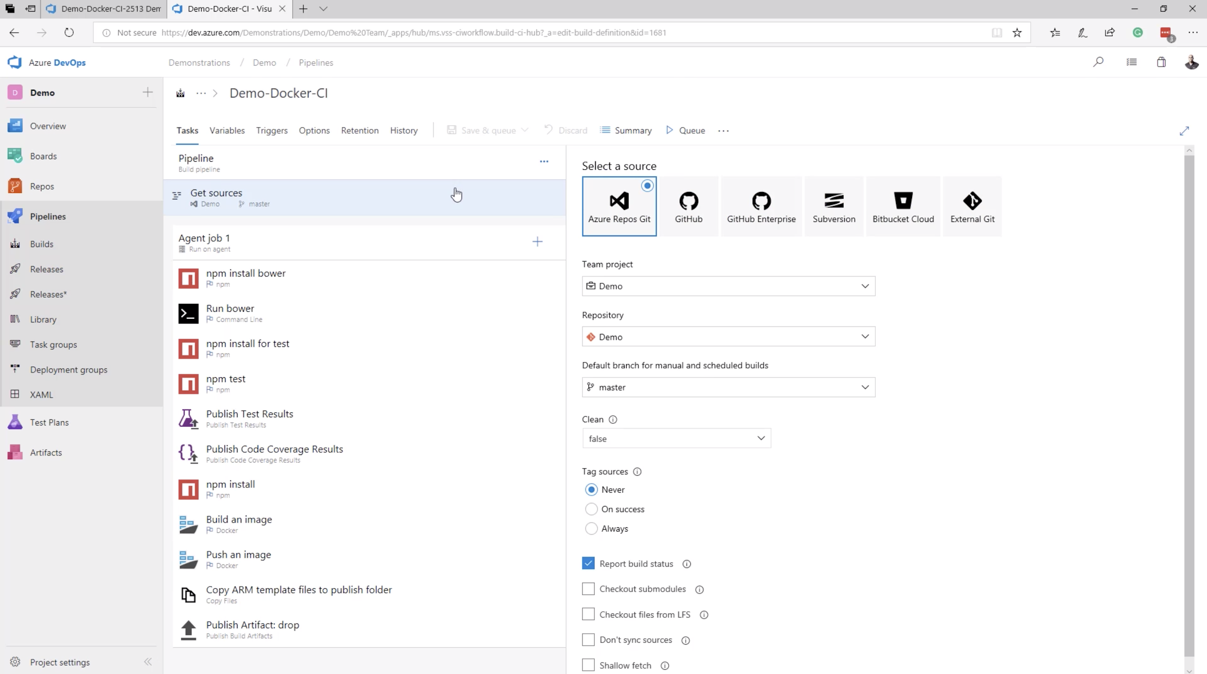
Lab 1: Azure DevOps

Slide 30
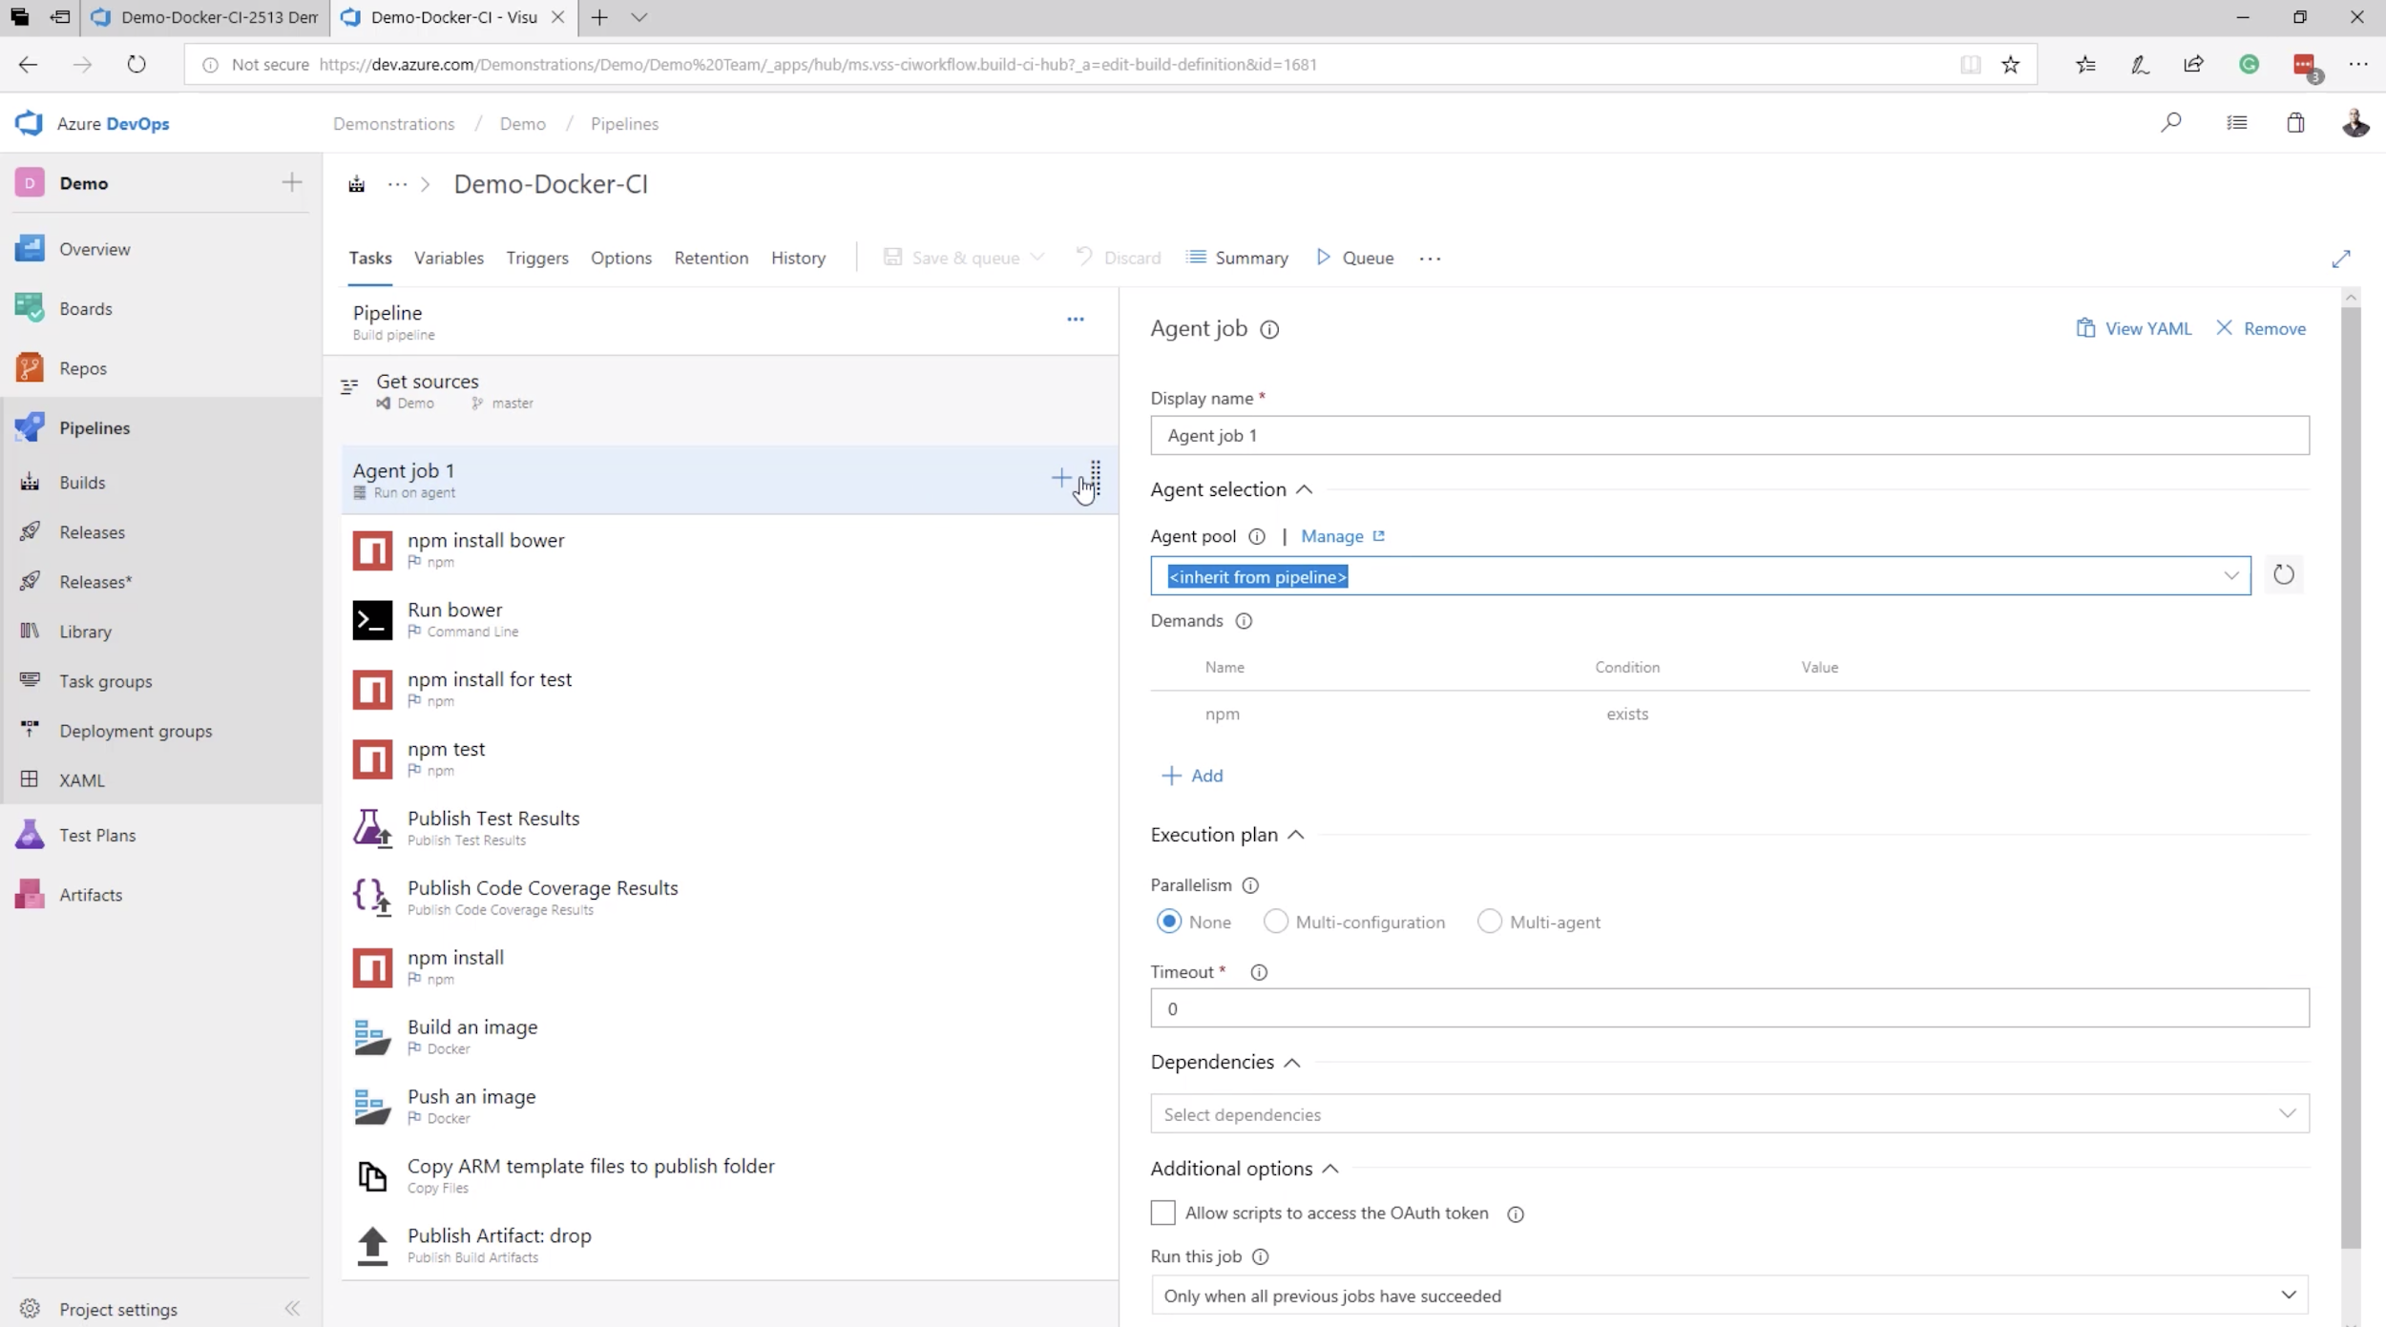
Lab 1: Azure DevOps

Slide 31
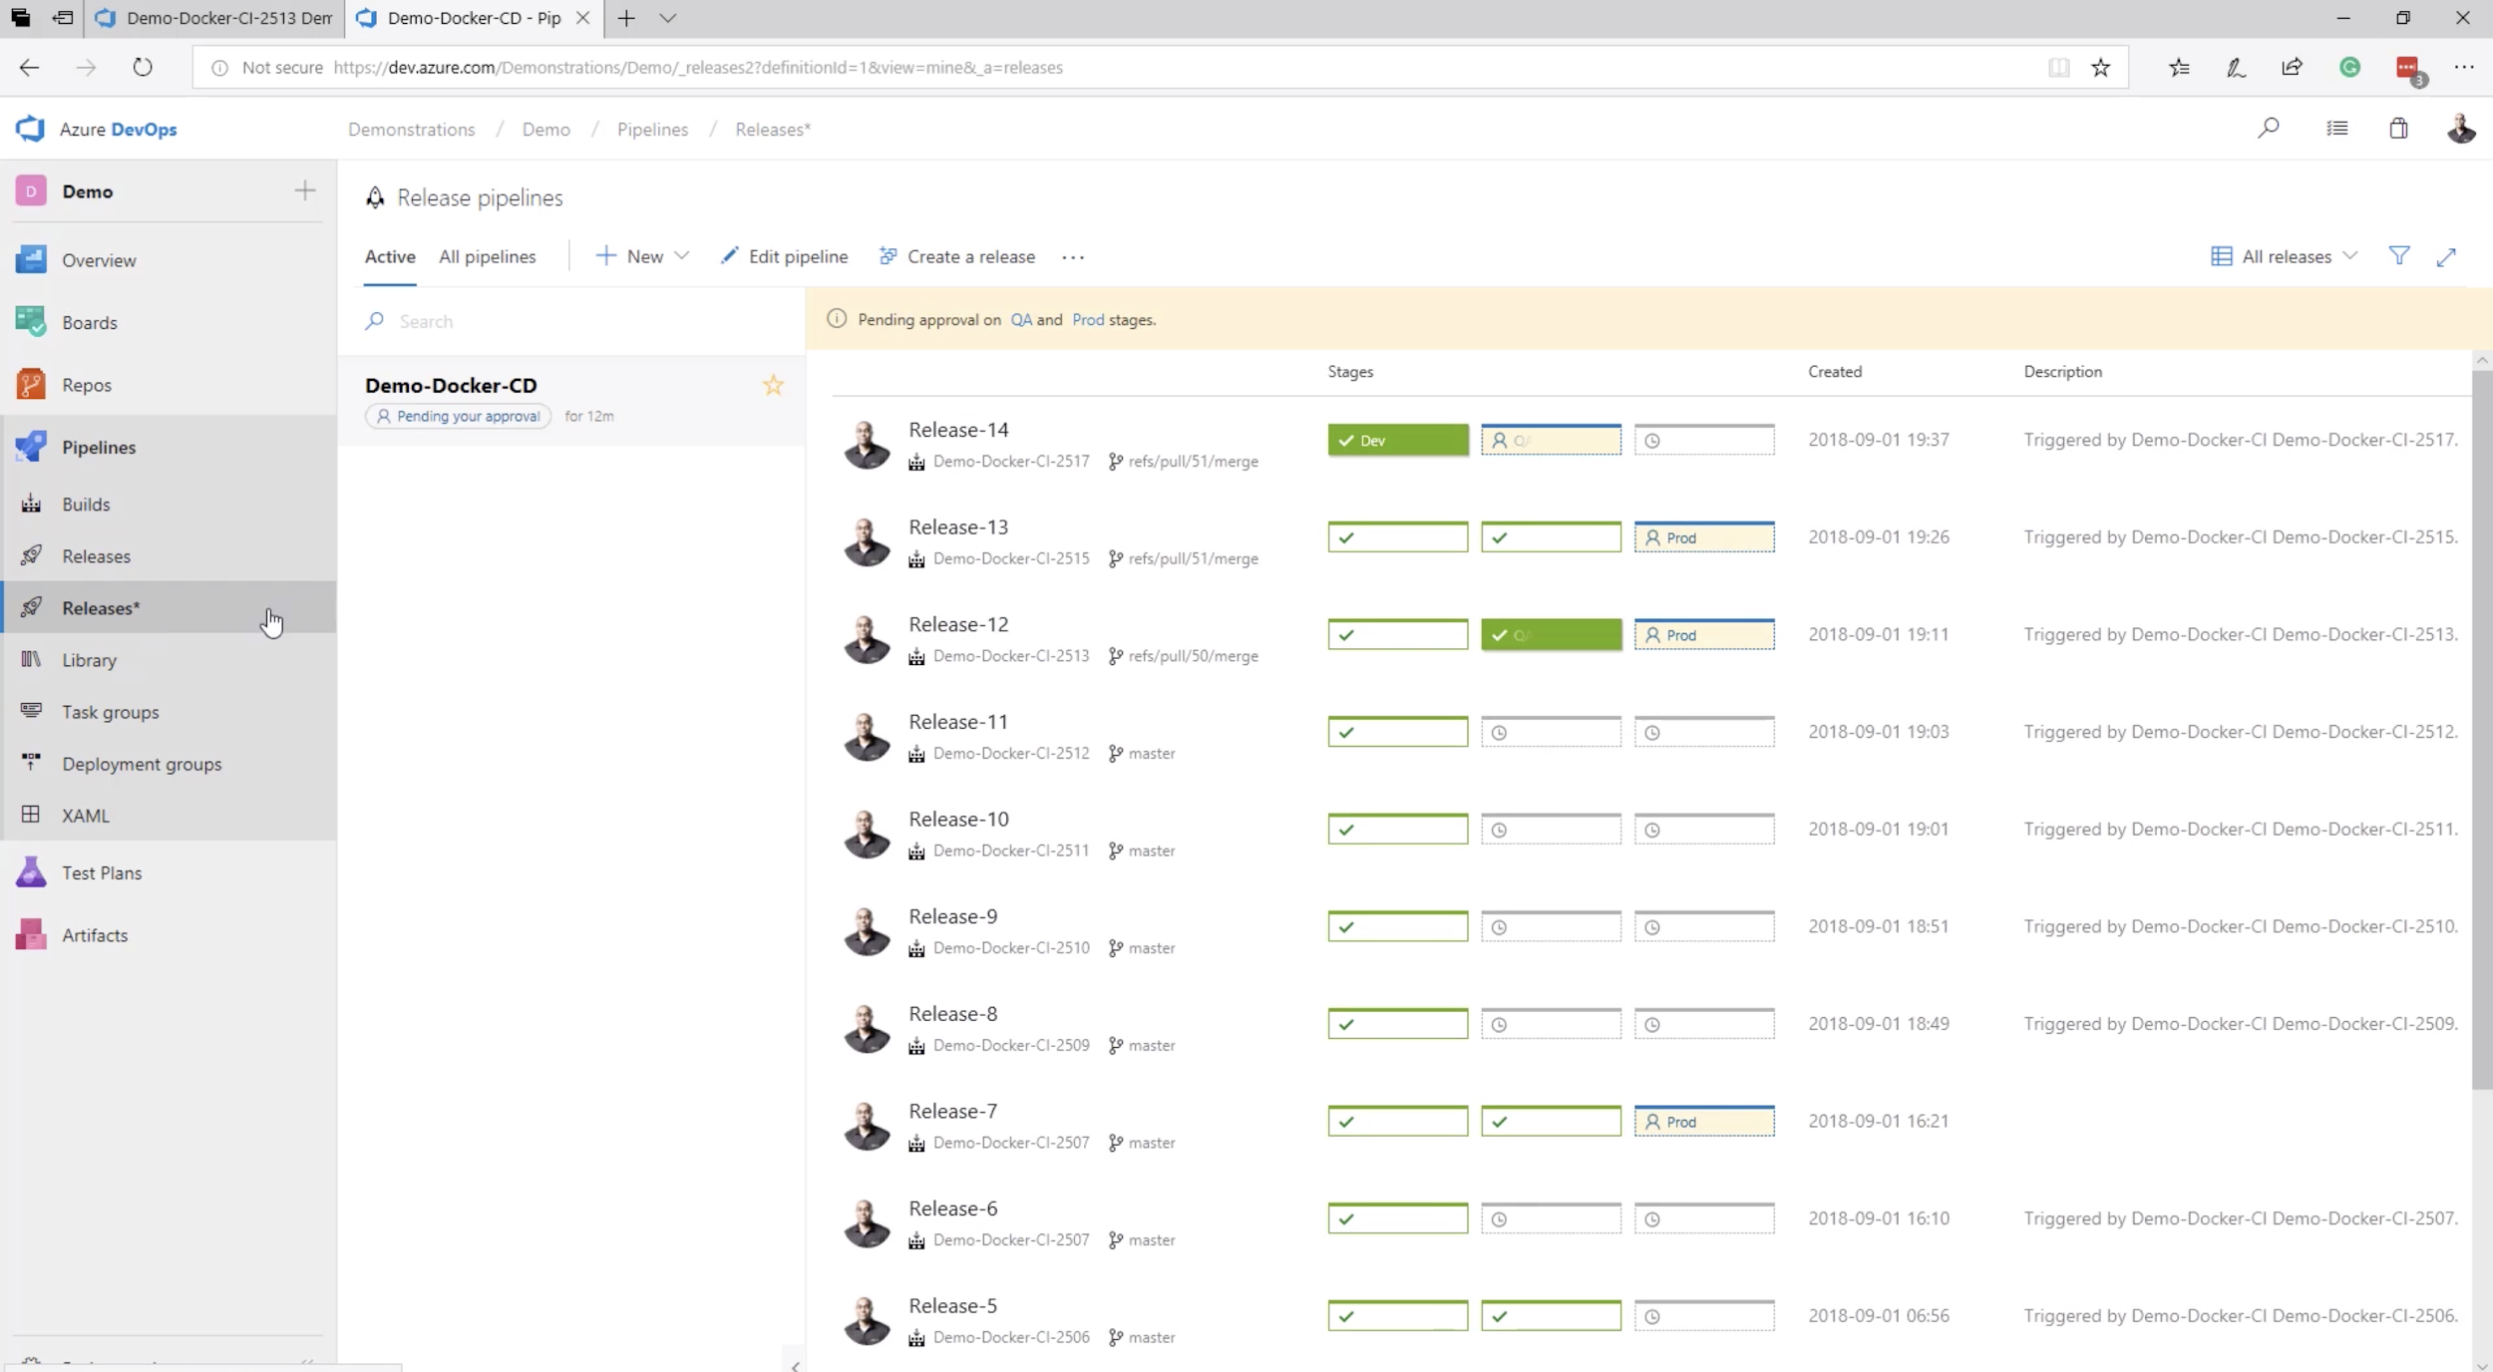
Lab 1: Azure DevOps

Slide 32
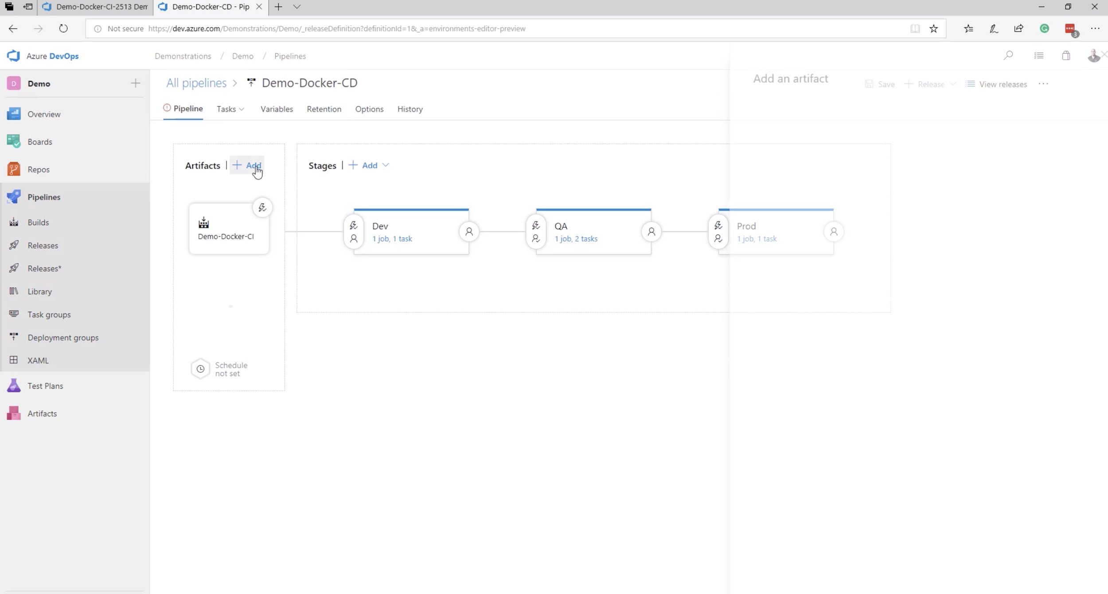
Lab 1: Azure DevOps

Slide 33
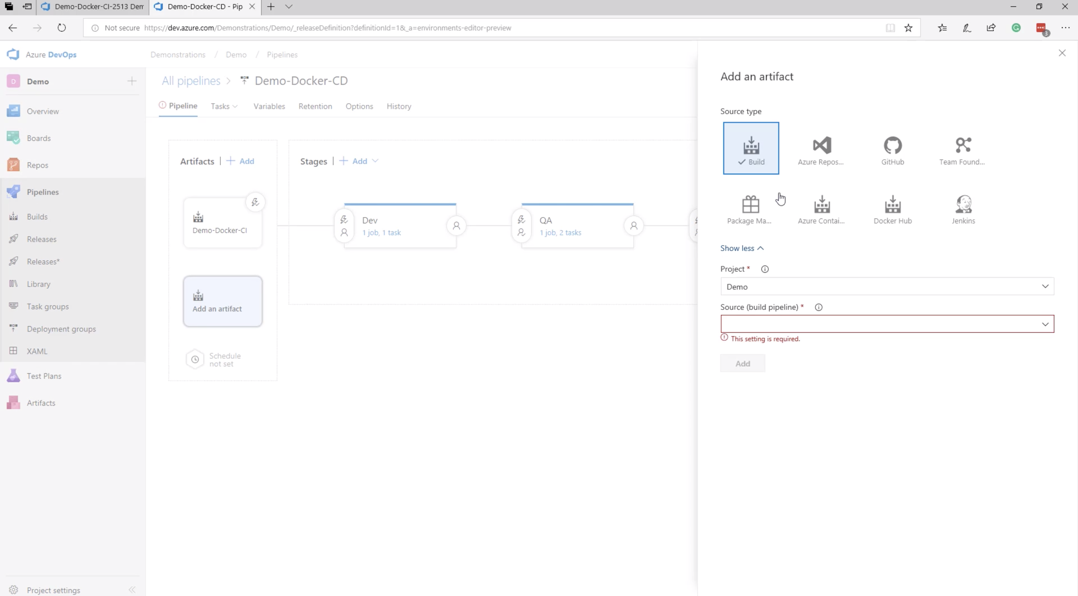
Lab 1: Azure DevOps

Slide 34
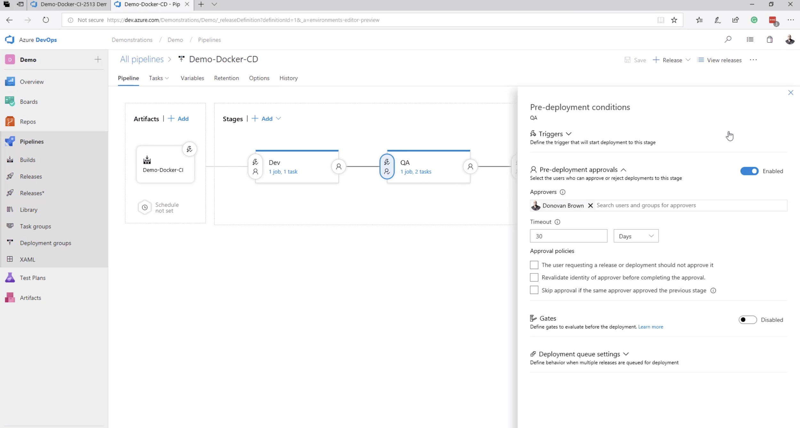
Lab 1: Azure DevOps

Slide 35
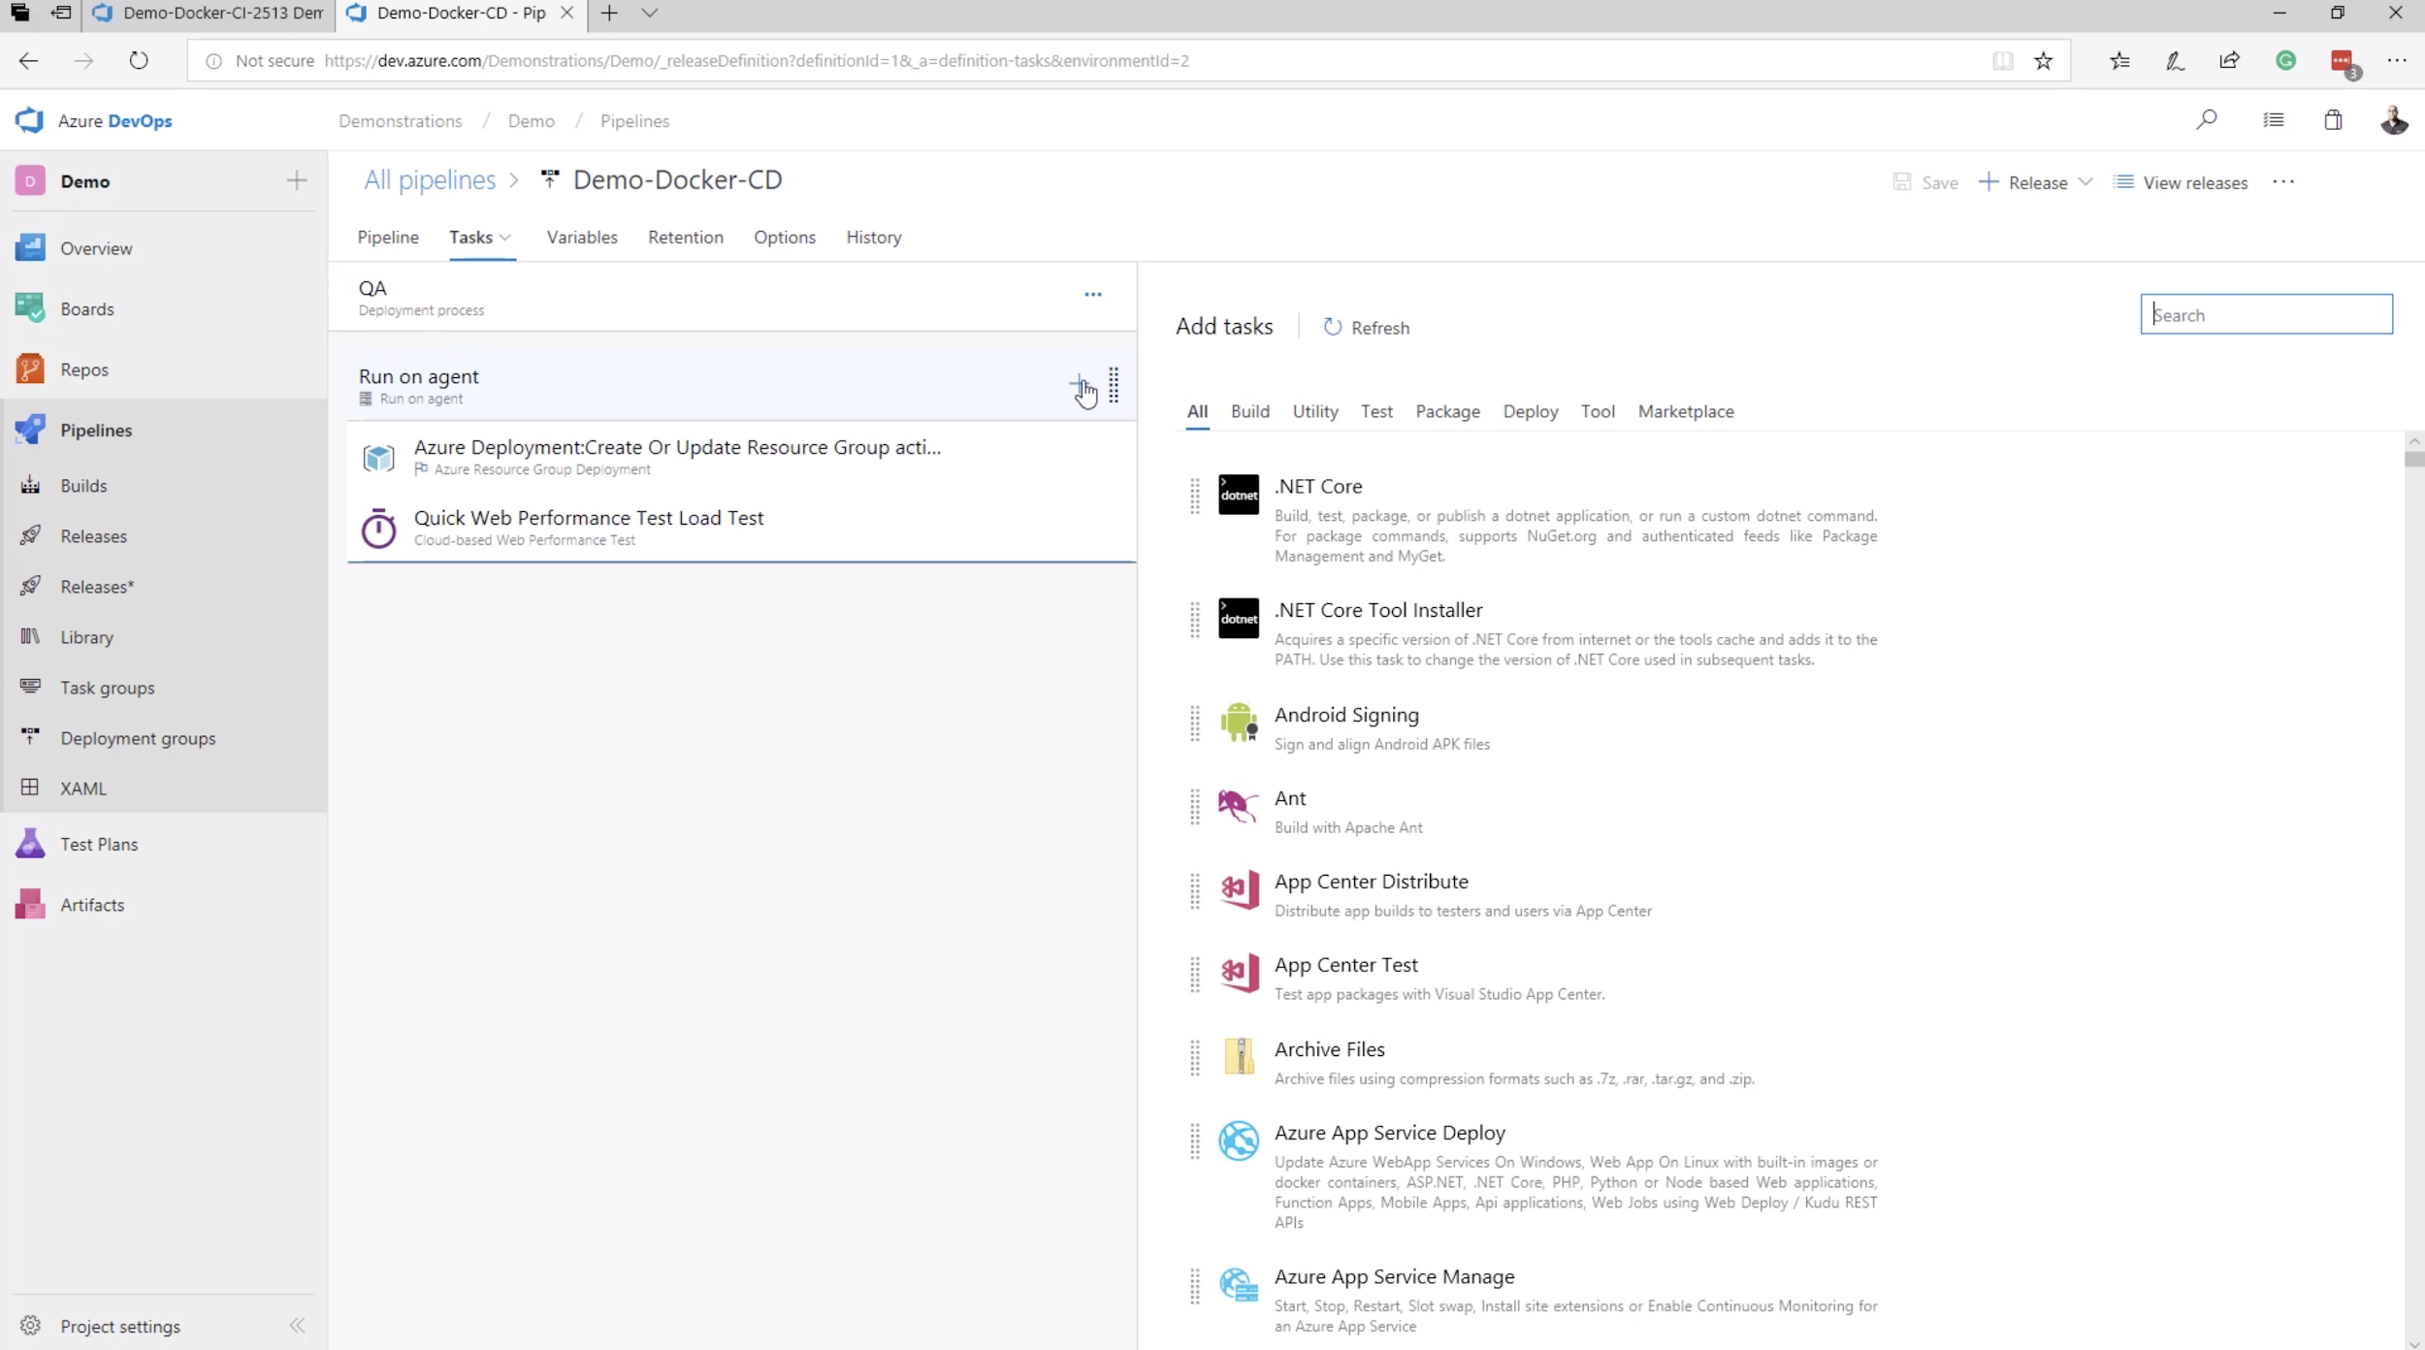
Lab 1: Azure DevOps

Slide 36
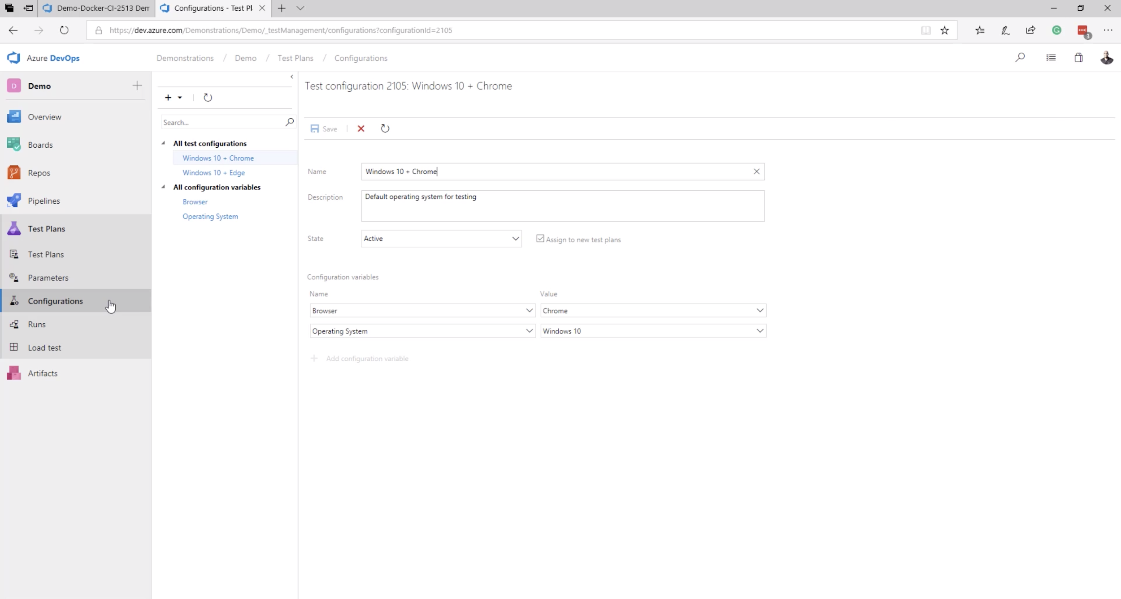
Lab 1: Azure DevOps

Slide 37
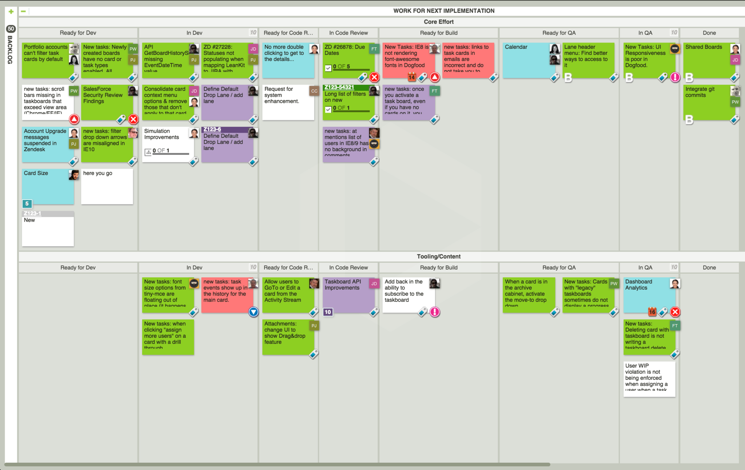
Lab 1: Azure DevOps - Example Kanban Board
https://leankit.com/learn/kanban/kanban-board-examples-for-development-and-operations/

Slide 38
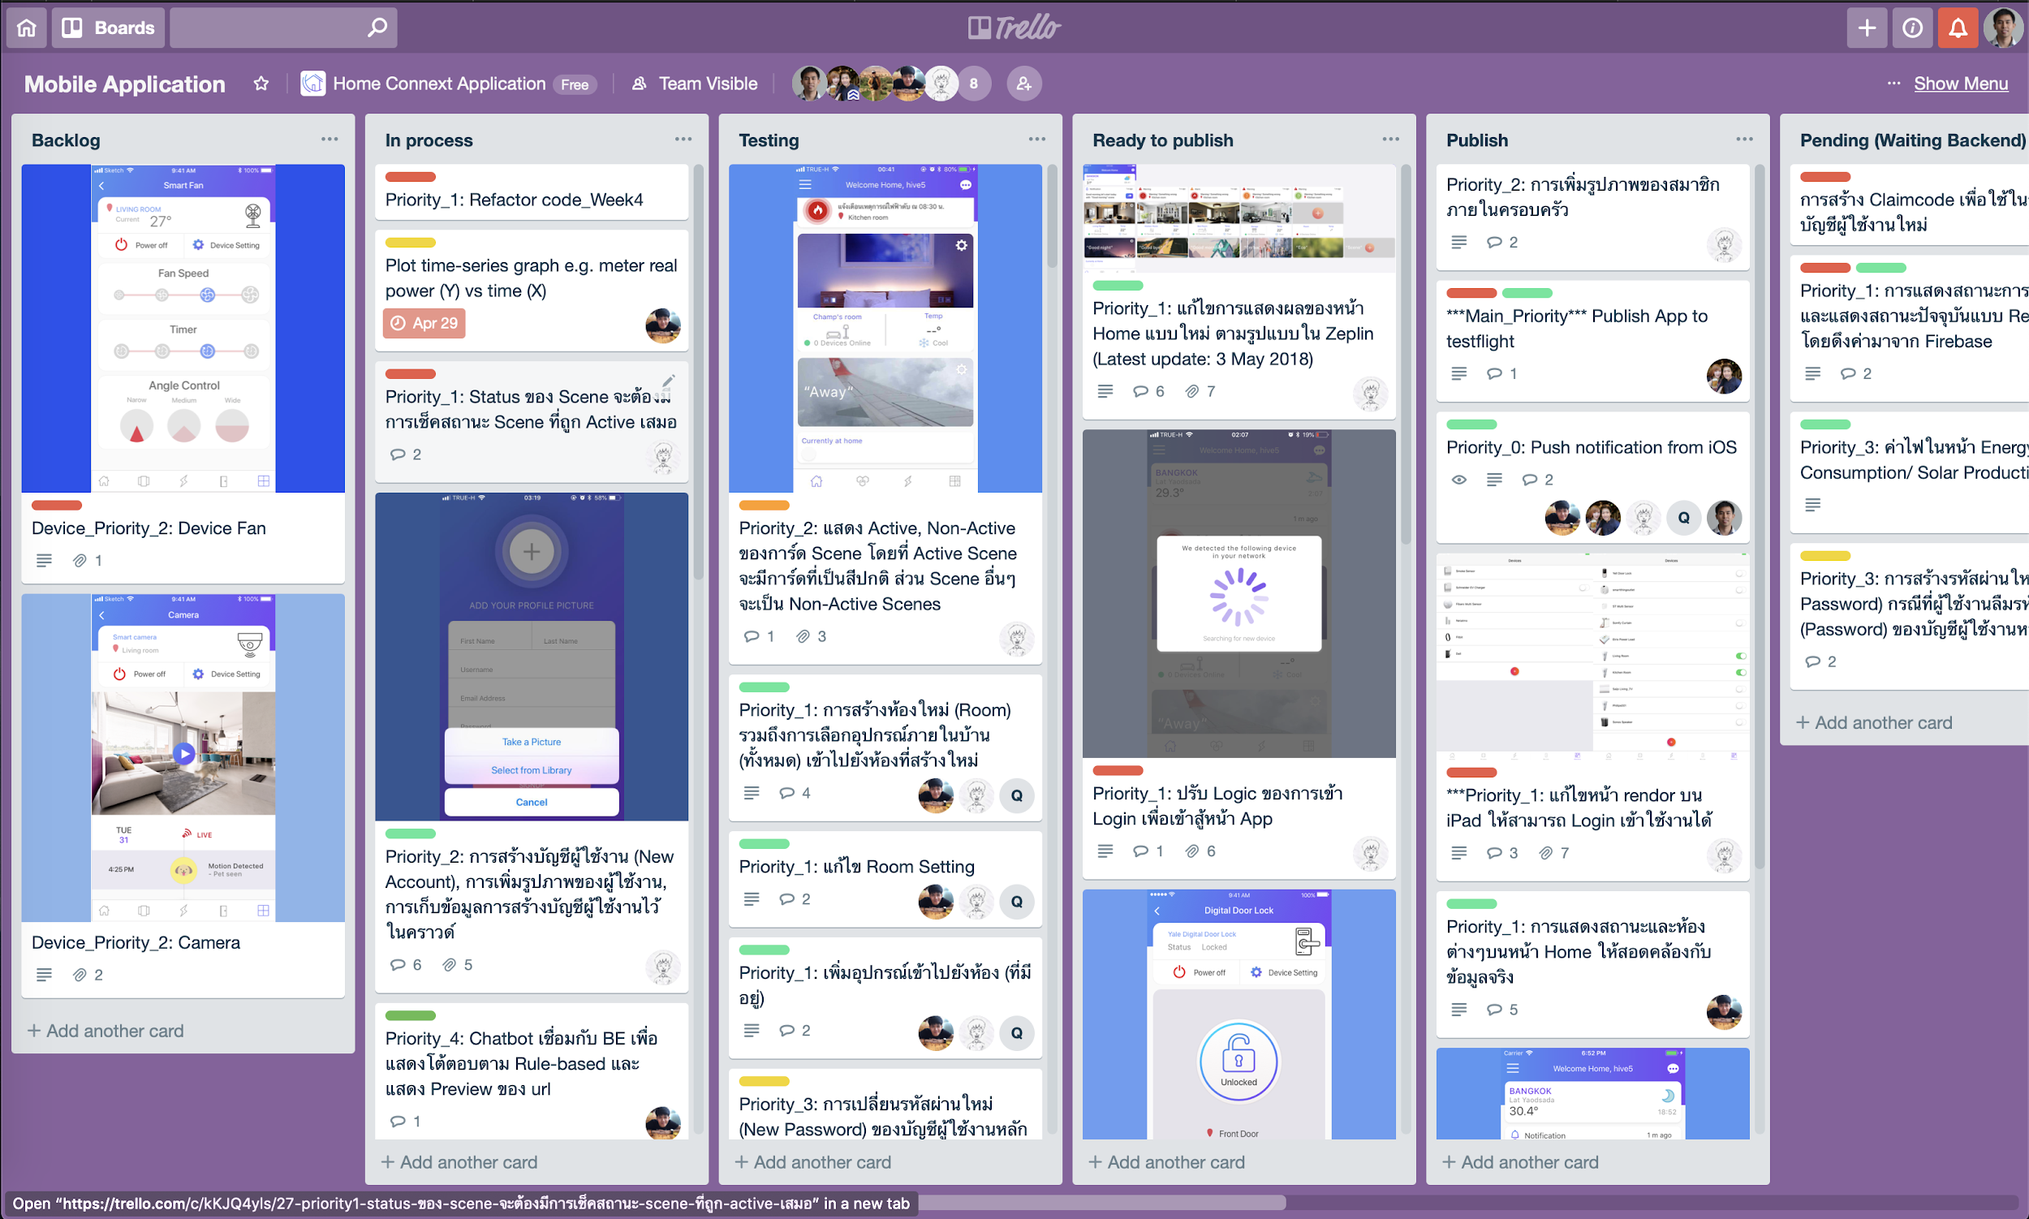
Lab 1: Azure DevOps - Example Kanban Board
https://leankit.com/learn/kanban/kanban-board-examples-for-development-and-operations/

Slide 39
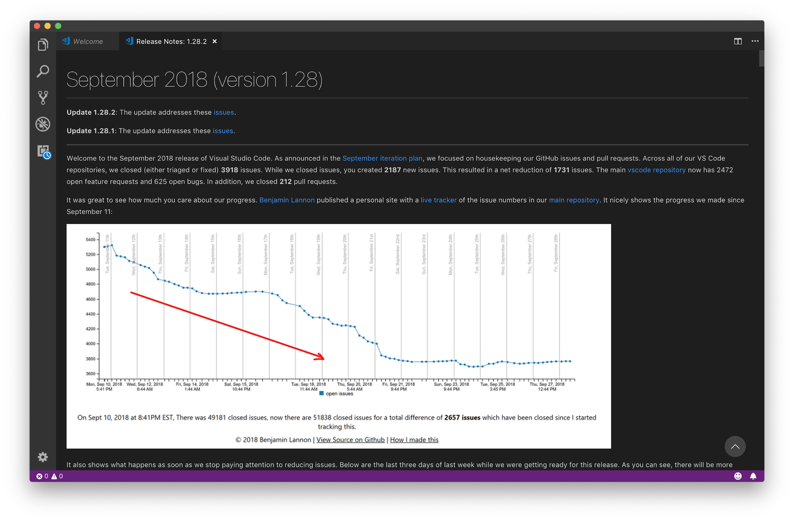
Lab 1: Azure DevOps

Slide 40
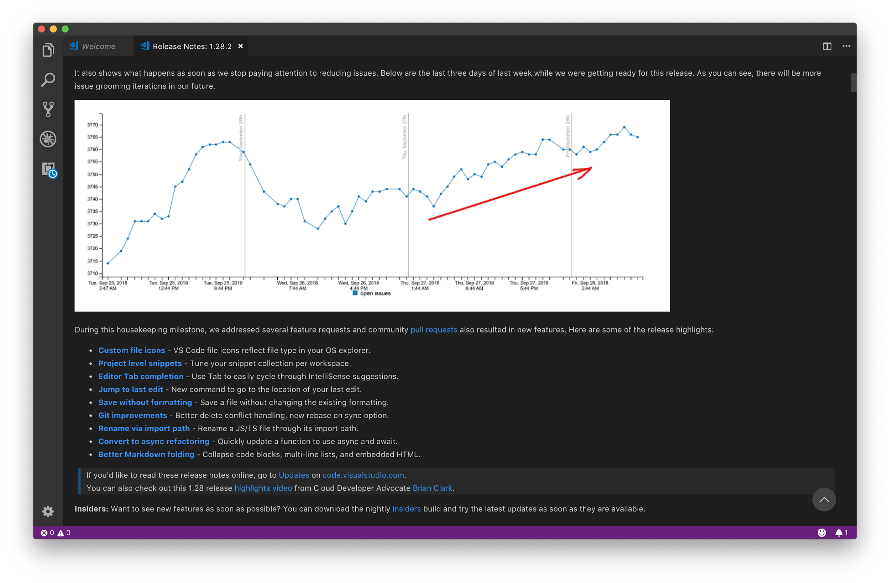
Lab 1: Azure DevOps

Slide 41
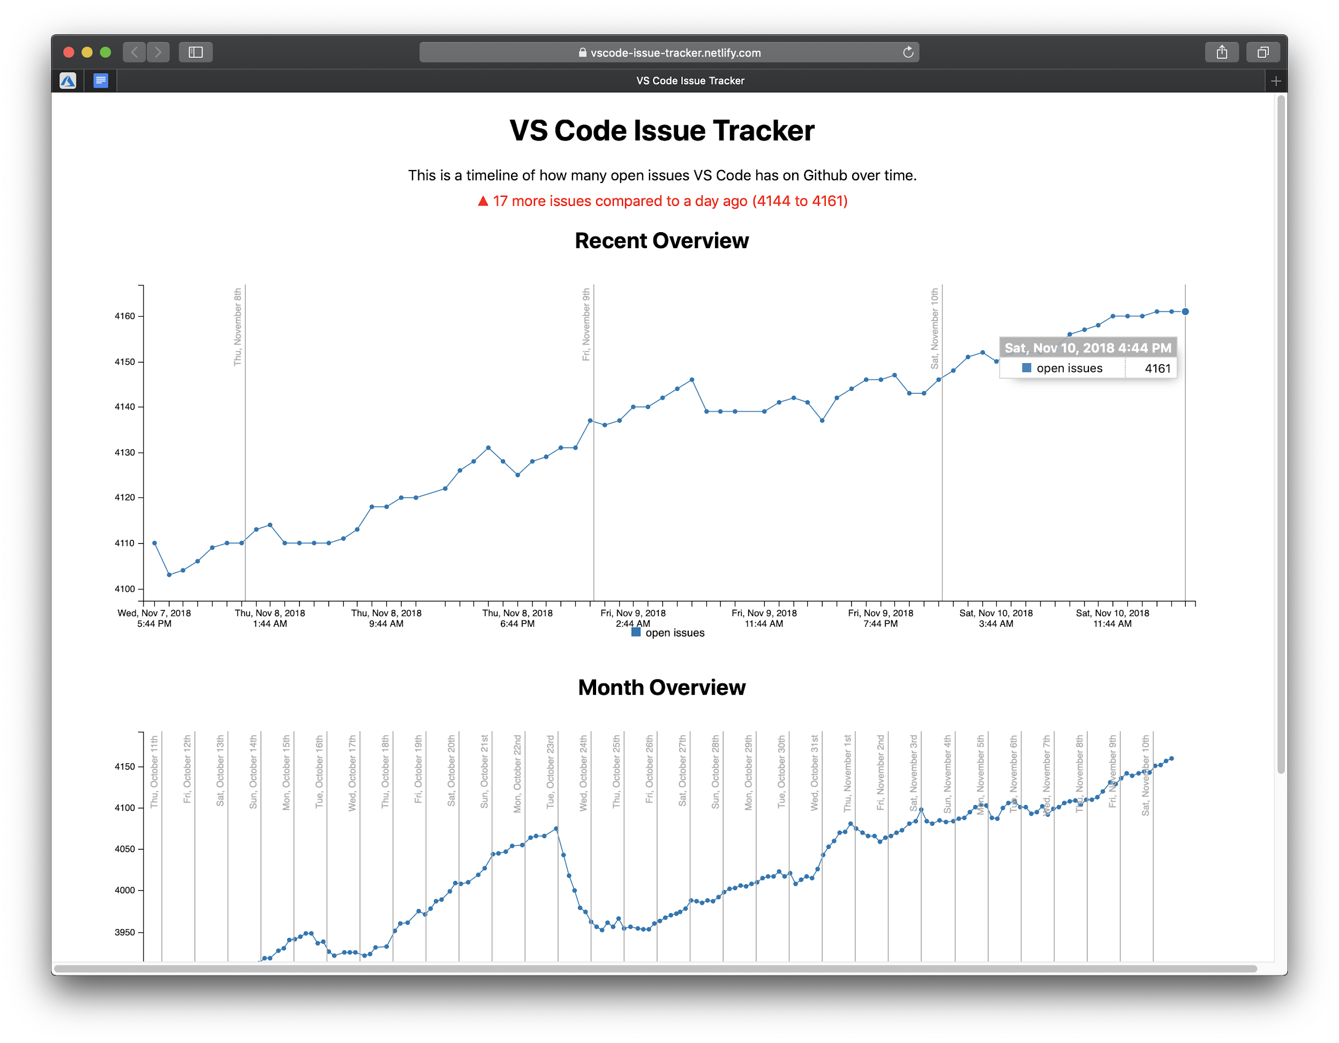
Lab 1: Azure DevOps
https://vscode-issue-tracker.netlify.com

Slide 42
Lab 1: Azure DevOps
Let’s get started

Slide 43
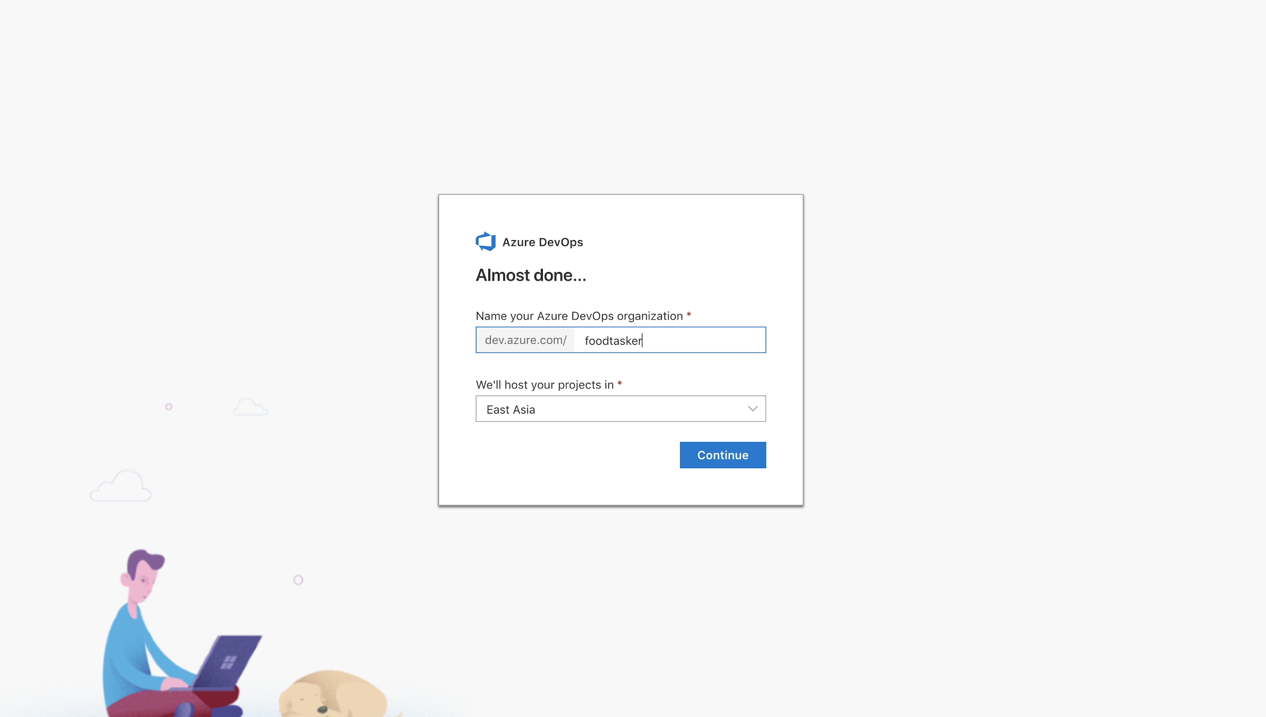
Lab 1: Azure DevOps - Create Organization

Slide 44
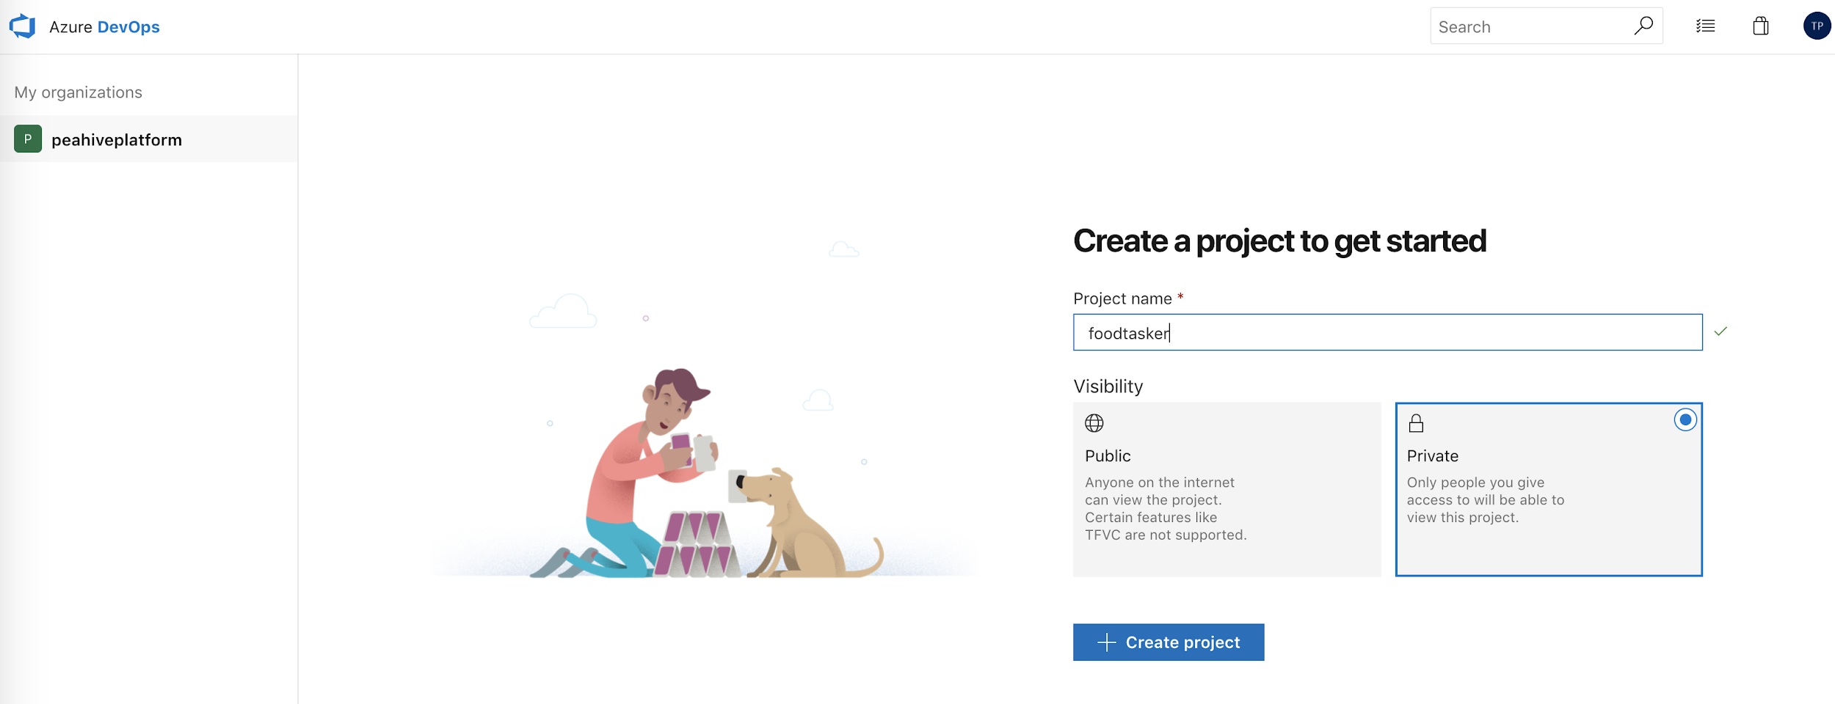
Lab 1: Azure DevOps - Create Project

Slide 45
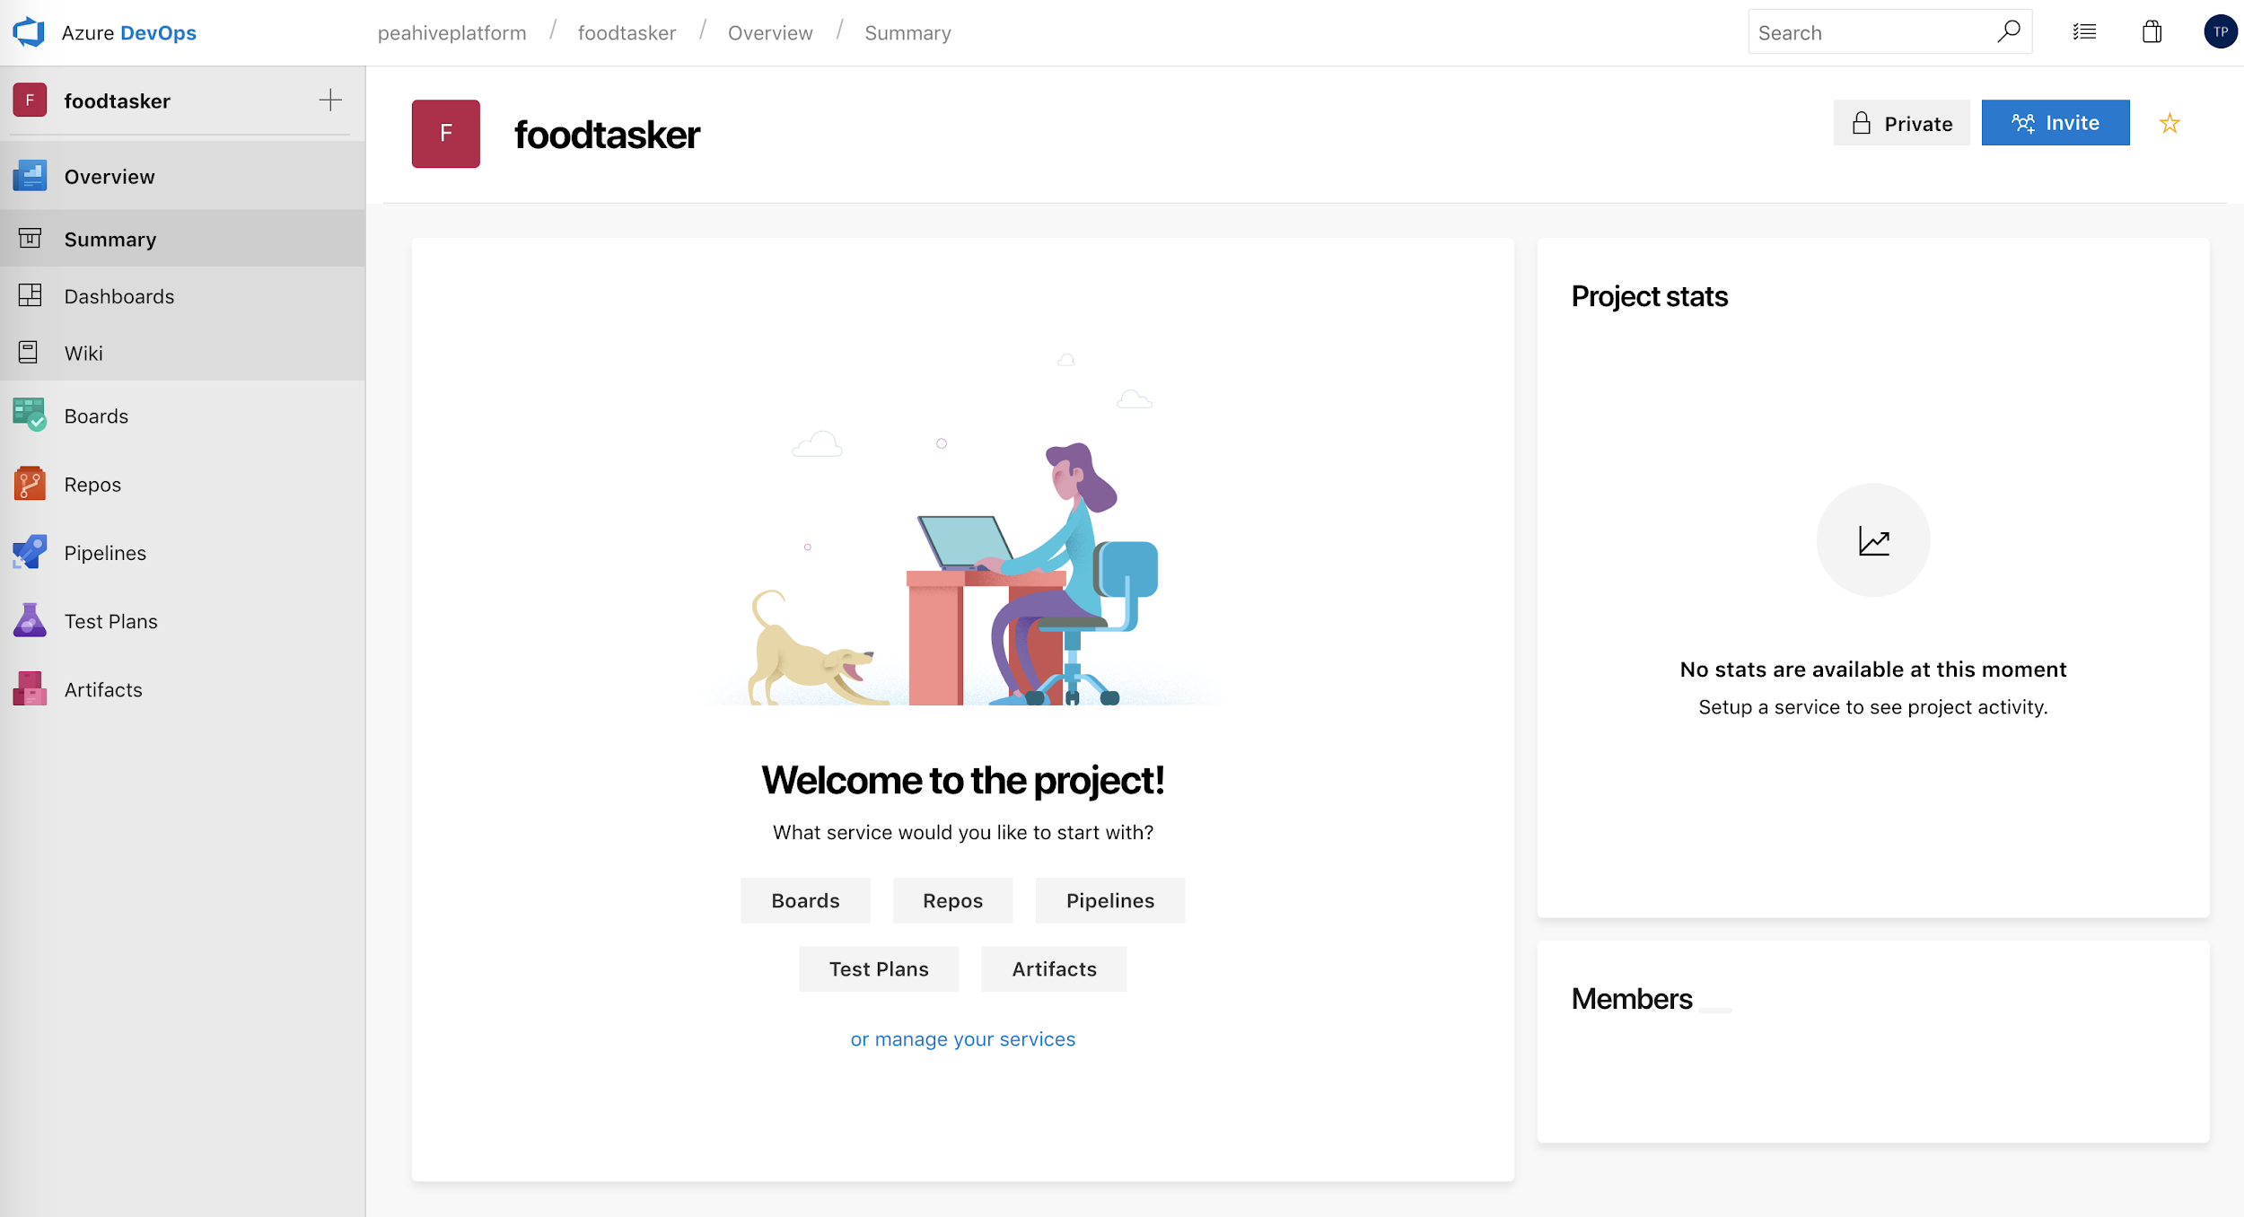
Lab 1: Azure DevOps

Slide 46
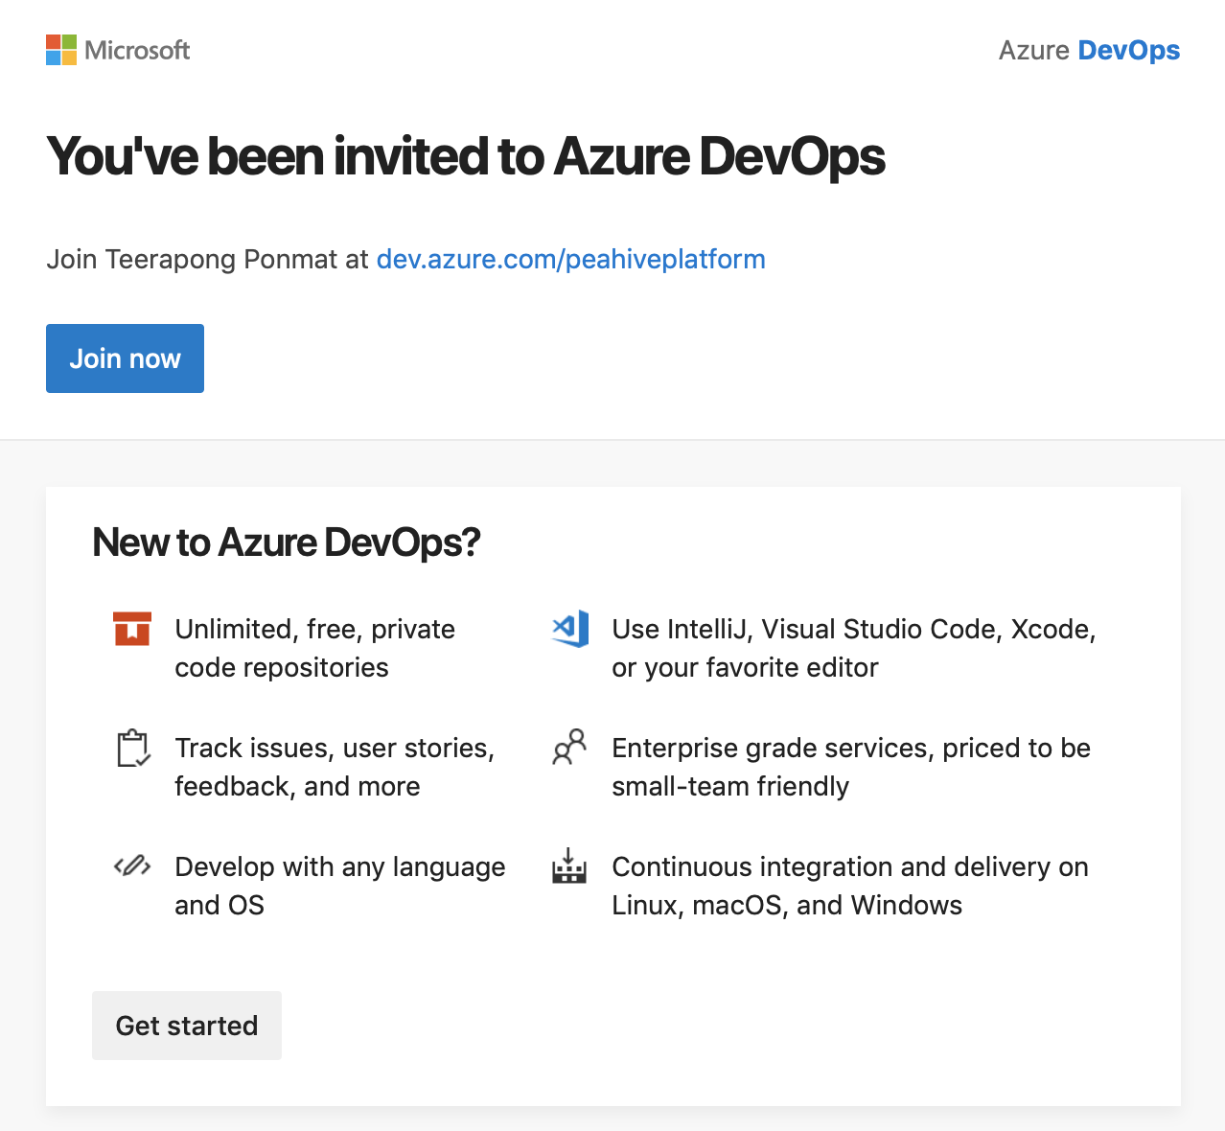
Lab 1: Azure DevOps

Slide 47
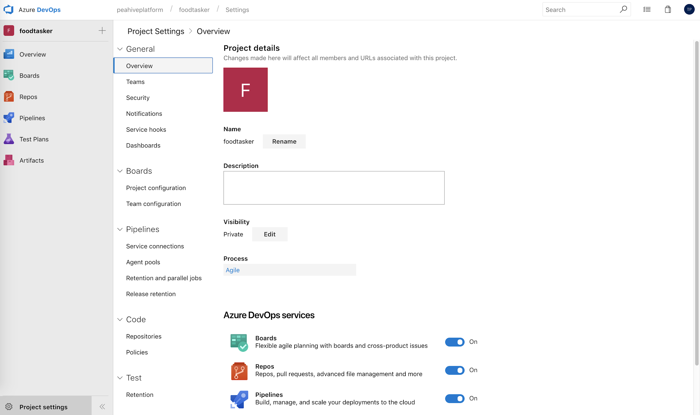
Lab 1: Azure DevOps

Slide 48
Lab 1: Azure DevOps
Prerequisites
Intialize your repository
Add a script to your repository
Create a build pipeline
Publish an artifact from your build
Enable continuous integration (CI)
Save and queue the build
Add some variables and commit a change to your script
You've got a build pipeline. What's next?
Create a release pipeline
Deploy a release
Change your code and watch it automatically deploy to production
Next steps
Azure Pipelines: Use the Visual Designer for CI/CD

Slide 49
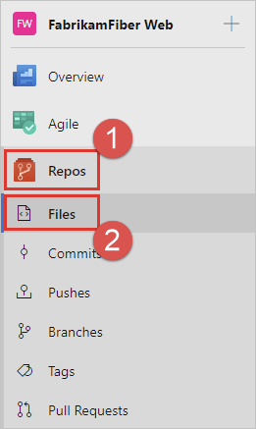
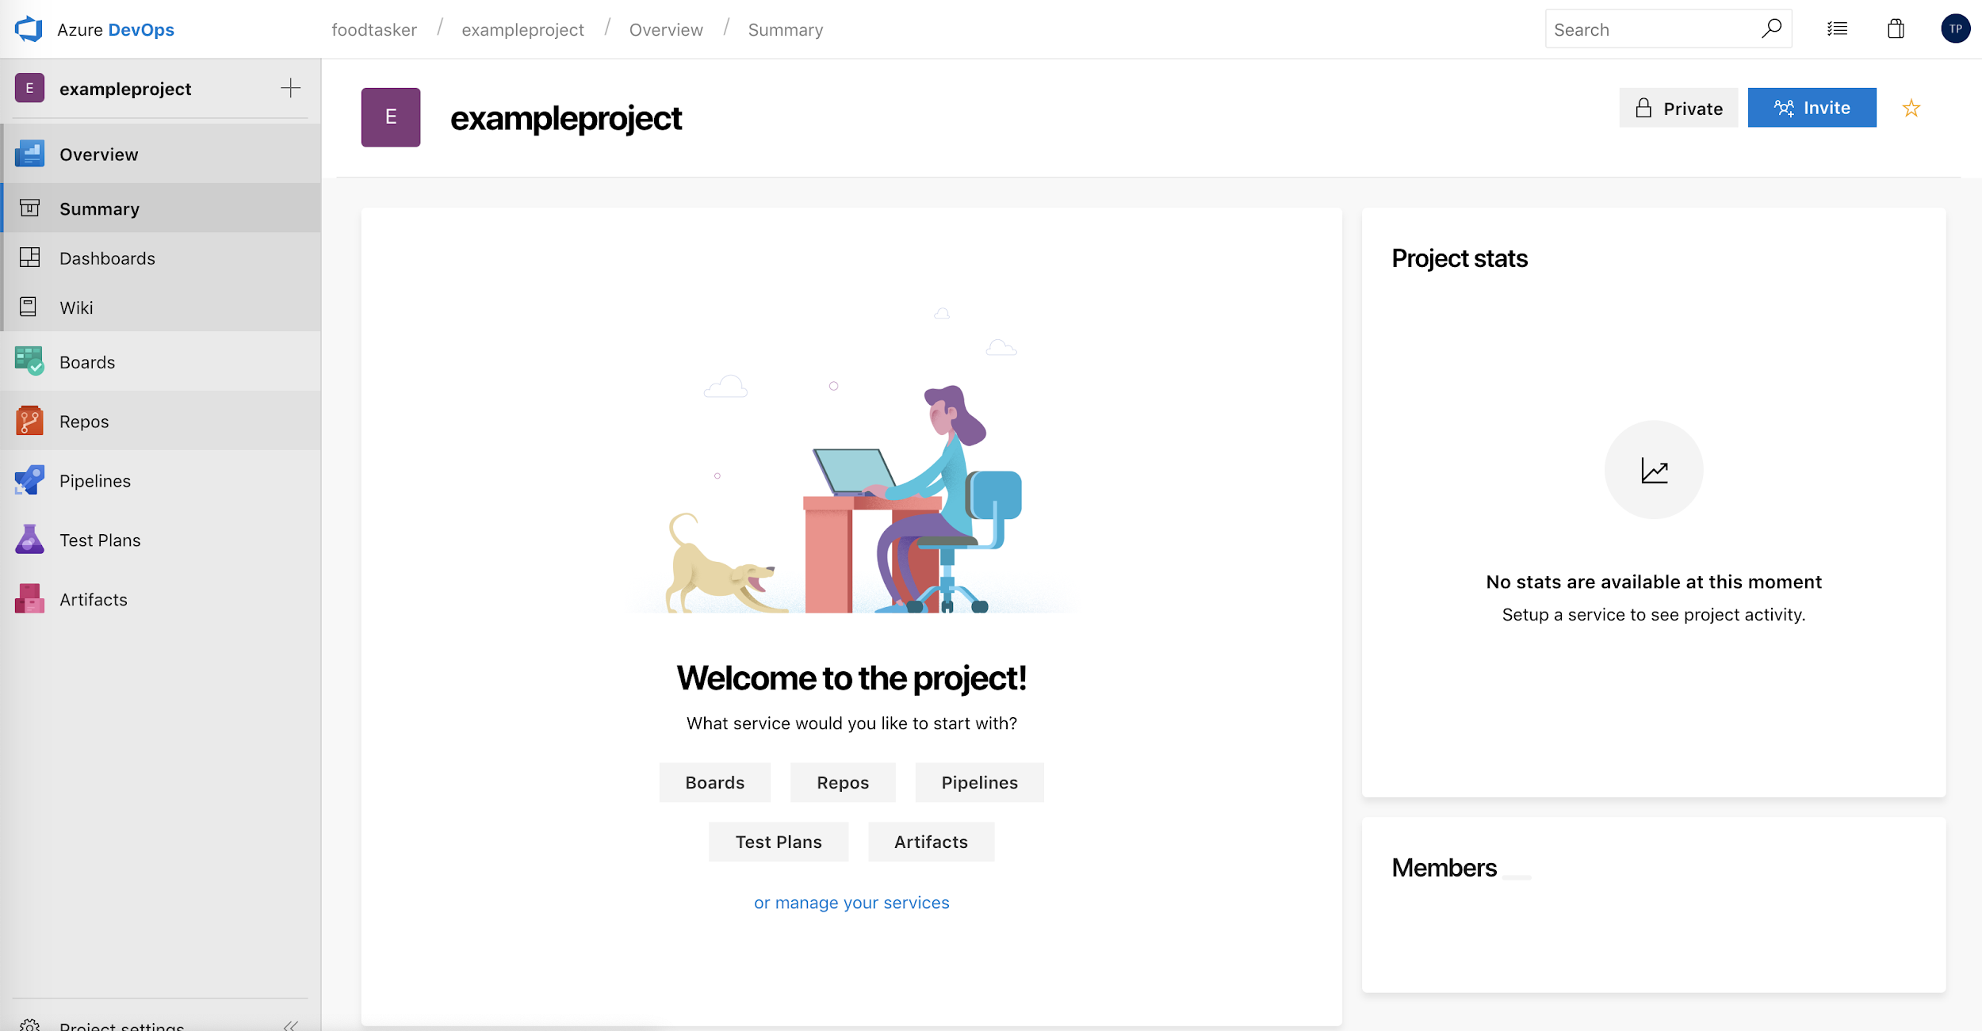
Lab 1: Azure DevOps - Step1: Initialize your repository
Go to Azure Repos. (The Code hub in the previous navigation)

Slide 50
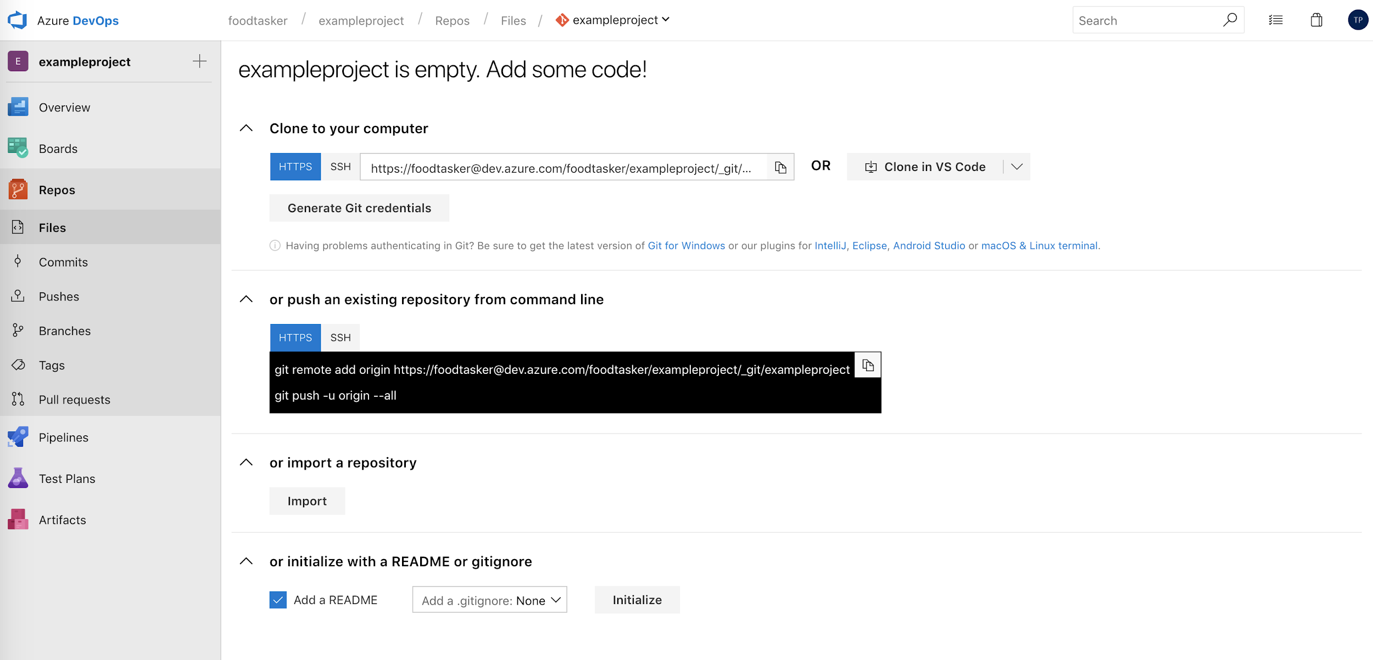
Lab 1: Azure DevOps
Initialize new repo

Slide 51
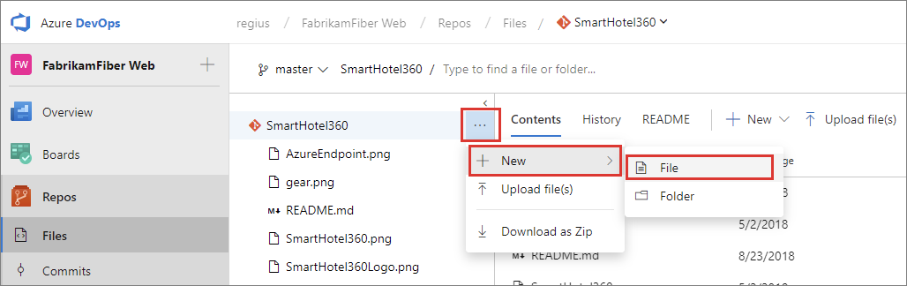
Lab 1: Azure DevOps - Step2 Add script to repo

Slide 52
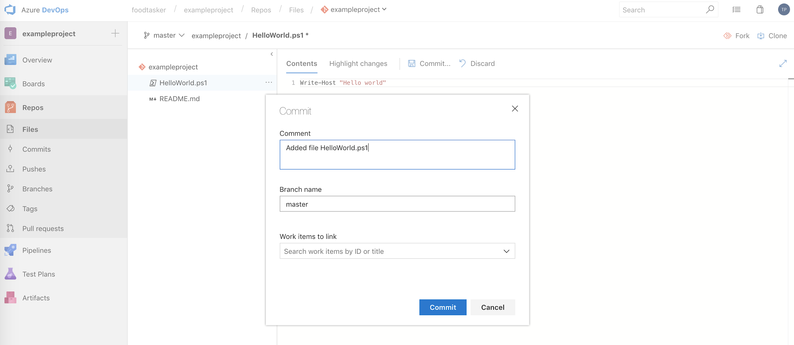
Lab 1: Azure DevOps - Step2 Add script to repo
1
2
3

Slide 53
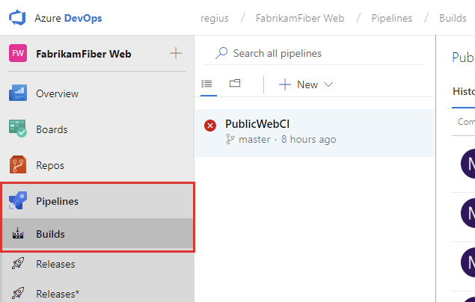
Lab 1: Azure DevOps - Step3 Create a build pipeline
Select Azure Pipelines

Slide 54

Lab 1: Azure DevOps - Step3 Create a build pipeline

Slide 55

Lab 1: Azure DevOps - Step3 Create a build pipeline
Click use the visual designer

Slide 56

Lab 1: Azure DevOps - Step3 Create a build pipeline

Slide 57

Lab 1: Azure DevOps - Step3 Create a build pipeline

Slide 58


Lab 1: Azure DevOps - Step3 Create a build pipeline
1
2
3

Slide 59

Lab 1: Azure DevOps - Step3 Create a build pipeline
2
1

Slide 60


Lab 1: Azure DevOps - Step3 Create a build pipeline
See YAML script

Slide 61

Lab 1: Azure DevOps - Step4 Publish an artifact from your build
A typical build produces an artifact that can then be deployed to various stages in a release.
2
1

Slide 62

Lab 1: Azure DevOps - Step4 Publish an artifact from your build
Artifacts are the files that you want your build to produce. Artifacts can be nearly anything your team needs to test or deploy your app. For example, you've got a .DLL and .EXE executable files and .PDB symbols file of a C# or C++ .NET Windows app.

Slide 63

Lab 1: Azure DevOps - Step5 Enable Continuous Integration (CI)
A continuous integration trigger on a build pipeline indicates that the system should automatically queue a new build whenever a code change is committed. You can make the trigger more general or more specific, and also schedule your build (for example, on a nightly basis)
1

Slide 64


Lab 1: Azure DevOps - Step6 Save and queue the build
1
2

Slide 65


Lab 1: Azure DevOps - Step6 Save and queue the build
Click to see build

Slide 66

Lab 1: Azure DevOps - Step6 Save and queue the build

Slide 67

Lab 1: Azure DevOps - Step6 Save and queue the build

Slide 68

Lab 1: Azure DevOps - Step7 See Summary
The script is published as an artifact.

Slide 69

Lab 1: Azure DevOps - Step8 Add some variable and commit change to your script
We'll pass some build variables to the script to make our pipeline a bit more interesting. Then we'll commit a change to a script and watch the CI pipeline run automatically to validate the change.
1. Edit the build pipeline
2. Select PowerShell

Slide 70

Lab 1: Azure DevOps - Step8 Add some variable and commit change to your script
2. Save
Add this argument

Slide 71

Lab 1: Azure DevOps - Step8 Add some variable and commit change to your script
Go back to files and edit HelloWorld.ps1

Slide 72



Lab 1: Azure DevOps - Step8 Add some variable and commit change to your script
Build automatically triggered
Artifact is created

Slide 73

Lab 1: Azure DevOps - Step8 Add some variable and commit change to your script
See the change

Slide 74
Lab 1: Azure DevOps - Step8 Add some variable and commit change to your script
You've just created a build pipeline that automatically builds and validates whatever code is checked in by your team.
Next you will learn about creating release pipelines.

Slide 75

Lab 1: Azure DevOps - Step9 Create a release pipeline
Define the process for running the script in two stages.
Create new release pipeline

Slide 76
Lab 1: Azure DevOps - Step9 Create a release pipeline
A release pipeline is a collection of stages to which the application build artifacts are deployed. It also defines the actual deployment pipeline for each stage, as well as how the artifacts are promoted from one stage to another.

Slide 77

Lab 1: Azure DevOps - Step9 Create a release pipeline
Start here

Slide 78

Lab 1: Azure DevOps - Step9 Create a release pipeline
1. Name stage QA
2. Add
3. Select artifact
4. Select Add

Slide 79

Lab 1: Azure DevOps - Step9 Create a release pipeline
2. Enable CD
1. Select lightning bolt

Slide 80

Lab 1: Azure DevOps - Step9 Create a release pipeline
1. Select Tasks
3. Browse Artifacts and select Script Path you need
2. Add Powershell
4. Add this Arguments

Slide 81

Lab 1: Azure DevOps - Step9 Create a release pipeline
Select Clone

Slide 82

Lab 1: Azure DevOps - Step9 Create a release pipeline
2. Change release pipeline name
3. save
1. Name Production

Slide 83
Lab 1: Azure DevOps - Step10 Deploy a release
Create a release

Slide 84

Lab 1: Azure DevOps - Step10 Deploy a release
Define the trigger settings and artifact source for the release and then select Create.

Slide 85

Lab 1: Azure DevOps - Step10 Deploy a release
Open release you’ve just created

Slide 86



Lab 1: Azure DevOps - Step10 Deploy a release
1.View logs
2. Detail of release

Slide 87
Lab 1: Azure DevOps - Step10 Deploy a release
You can track the progress of each release to see if it has been deployed to all the stages. You can track the commits that are part of each release, the associated work items, and the results of any test runs that you've added to the release pipeline.

Slide 88

Lab 1: Azure DevOps - Step11 change code to automatically deployed to production
2. Commit
1. Edit HelloWorld.ps1

Slide 89


Lab 1: Azure DevOps - Step12 Select Build tab to see the build queued and run

Slide 90

Lab 1: Azure DevOps - Step12 Select Build tab to see the build queued and run

Slide 91

Lab 1: Azure DevOps - Step13 Select Release tab and see the logs

Slide 92


Lab 1: Azure DevOps - Step13 Select Release tab and see the logs

Slide 93

Lab 1: Azure DevOps - Step13 Select Release tab and see the logs

Slide 94

Lab 1: Azure DevOps - Step13 Select Release tab and see the logs

Slide 95
Lab 2: Azure DevOps
Create CI/CI Pipeline for Python

Slide 96

Lab 2: Azure DevOps - Step1 Go to Azure Portal
Go to
portal.azure.com
Create DevOps Project

Slide 97

Lab 2: Azure DevOps - Step2 Select Python sample project
Select Python

Slide 98

Lab 2: Azure DevOps - Step2 Select Python sample project
Choose Django

Slide 99

Lab 2: Azure DevOps - Step2 Select Python sample project
Choose Web App for Containers

Slide 100

Lab 2: Azure DevOps - Step2 Select Python sample project
1.Project Name
2.Web App Name
3.Deployed location

Slide 101

Lab 2: Azure DevOps - Step2 Select Python sample project
Click

Slide 102

Lab 2: Azure DevOps - Step2 Select Python sample project
This dashboard provides visibility into your code repository, Azure CI/CD pipeline, and your application in Azure
The Azure DevOps Project automatically configures a CI build and release trigger. You're now ready to collaborate with a team on a Python app with a CI/CD process that automatically deploys your latest work to your web site.

Slide 103

Lab 2: Azure DevOps - Step2 Select Python sample project

Slide 104

Lab 2: Azure DevOps - Step2 Select Python sample project

Slide 105

Lab 2: Azure DevOps - Step2 Select Python sample project

Slide 106

Lab 2: Azure DevOps - Step2 Select Python sample project

Slide 107
Lab 2: Azure DevOps - Step2 Select Python sample project
Commit code changes and execute CI/CD

Slide 108

Lab 2: Azure DevOps - Step2 Select Python sample project
Try to change this code

Slide 109
Lab 2: Azure DevOps - Step2 Select Python sample project
Examine the Azure CI/CD pipeline

Slide 110
Lab 2: Azure DevOps - Step2 Select Python sample project
Build

Slide 111

Lab 2: Azure DevOps - Step2 Select Python sample project

Slide 112

Lab 2: Azure DevOps - Step2 Select Python sample project

Slide 113

Lab 2: Azure DevOps - Step2 Select Python sample project

Slide 114


Lab 2: Azure DevOps - Step2 Select Python sample project

Slide 115


Lab 2: Azure DevOps - Step2 Select Python sample project

Slide 116

Lab 2: Azure DevOps - Step2 Select Python sample project
In case you want to change branch and release to staging and prod envs

Slide 117

Lab 1: Azure DevOps
https://docs.microsoft.com/en-us/azure/devops/learn/

